Slide 1
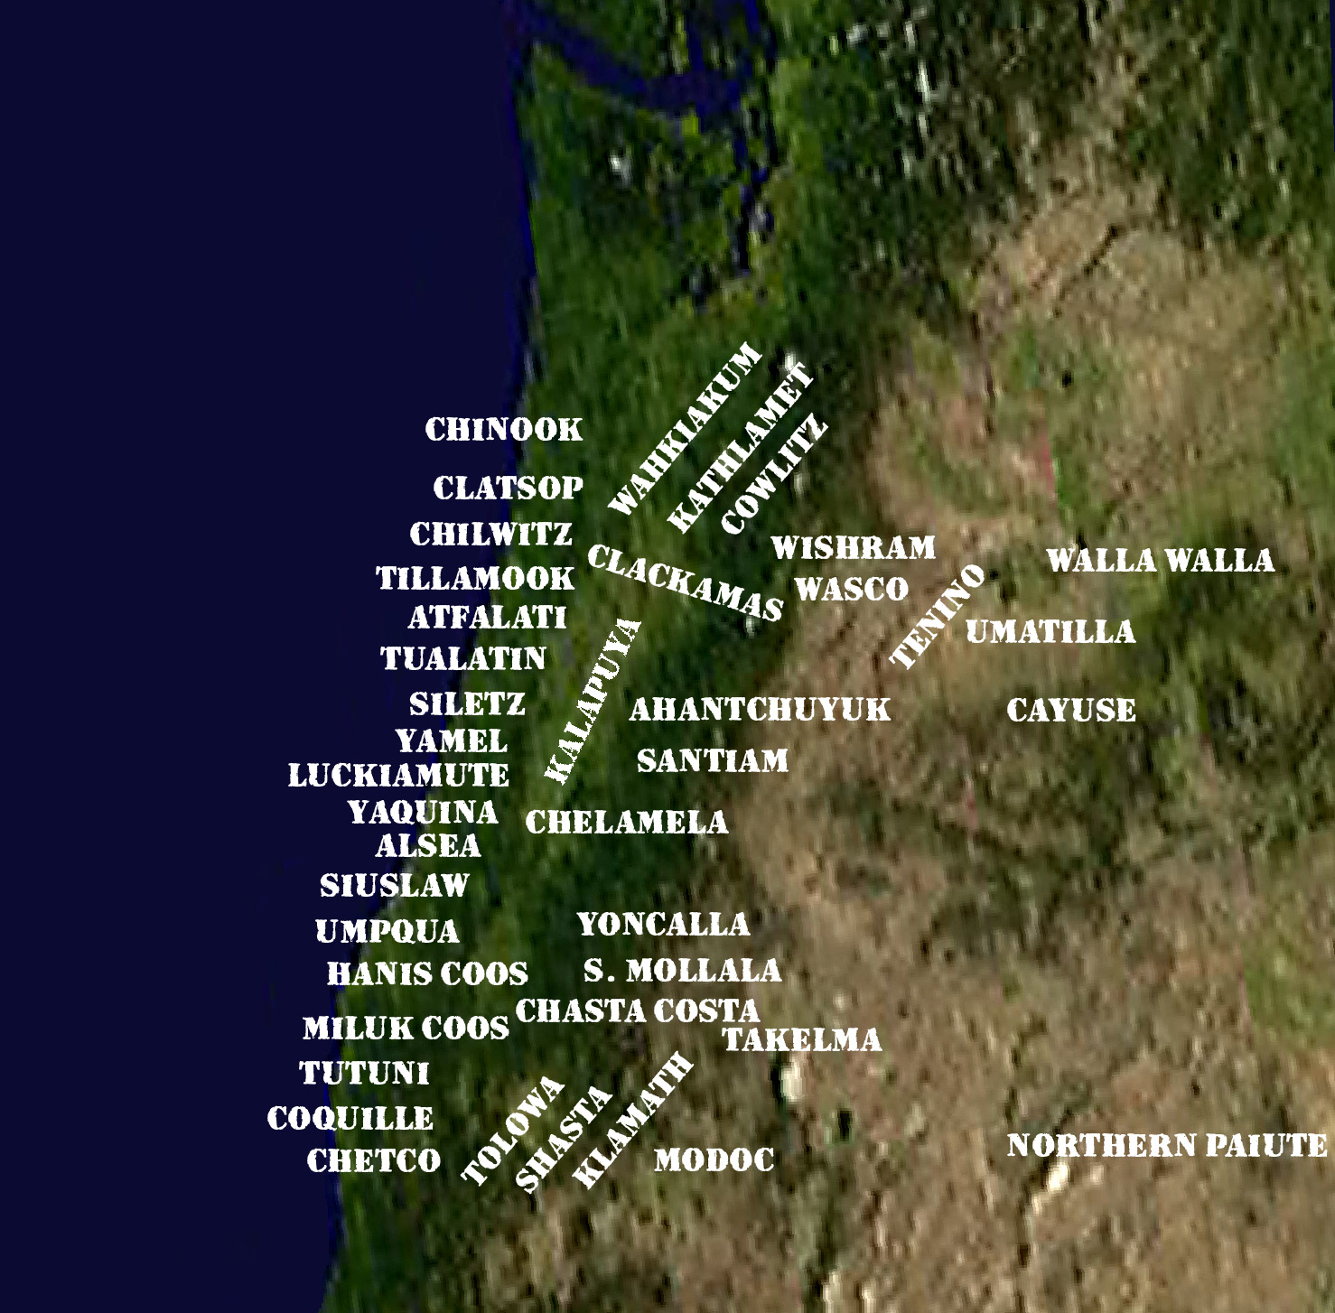
University of Oregon Land Acknowledgement
Native American peoples of Oregon
UO Libraries Resources
Honoring Native Peoples and Lands

Slide 2
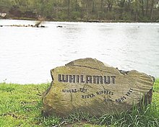
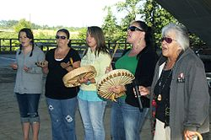
Land Acknowledgement
"The University of Oregon is located on Kalapuya Ilihi (Cal-uh-POO-yuh ILLihee), the traditional indigenous homeland of the Kalapuya people. Following treaties between 1851 and 1855, Kalapuya people were dispossessed of their indigenous homeland by the United States government and forcibly removed to the Coast Reservation in Western Oregon.
Kalapuyan languages
One of the boulders engraved with Kalapuyan words along the paths of east Alton Baker Park in Eugene, Oregon; this one is next to the Willamette River: Whilamut (meaning, Where the river ripples and runs fast)
Kalapuya
Esther Stutzman, a Kalapuya elder, leads her daughters in a Kalapuya welcome song, 2009.
Total population
estimated 4,000
Regions with significant populations
United States United States ( Oregon)
Languages
English language, formerly Kalapuya language^{[1]}
Treaties between 1851 and 1855
Coast Reservation in Western Oregon.

Slide 3
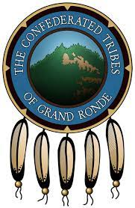

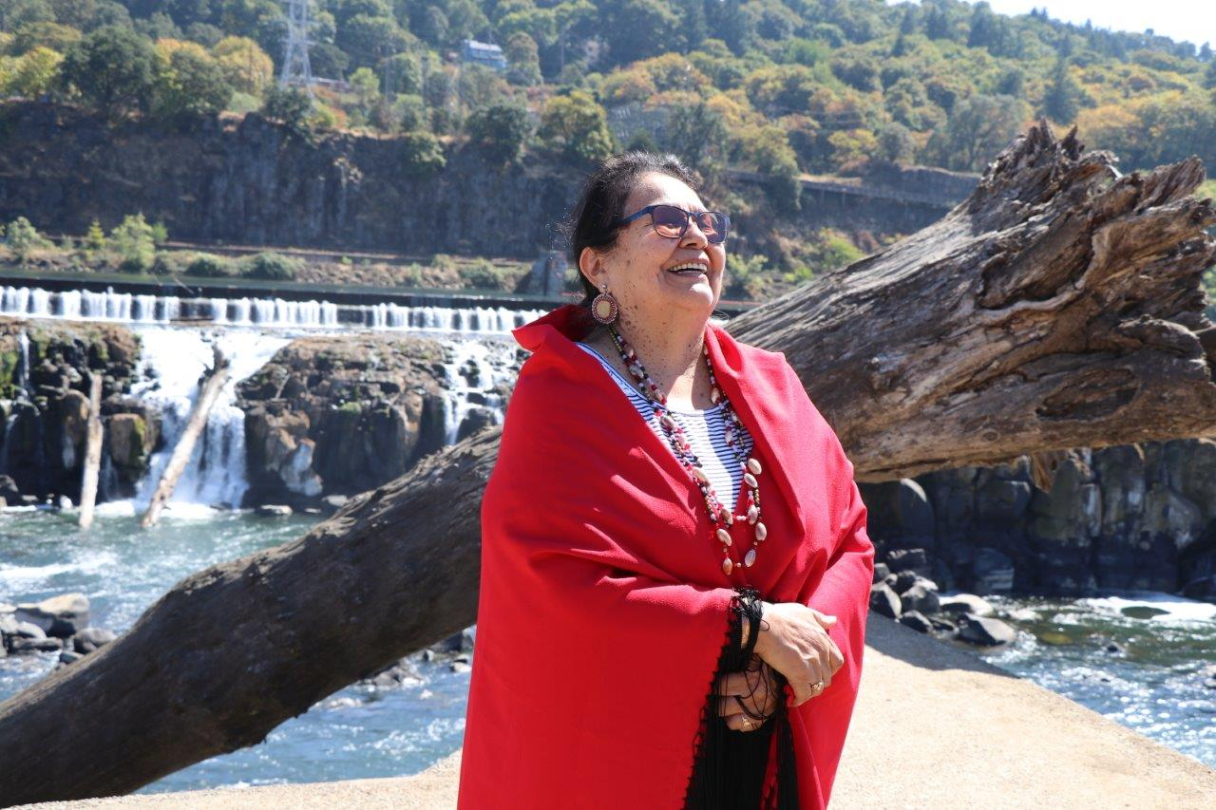
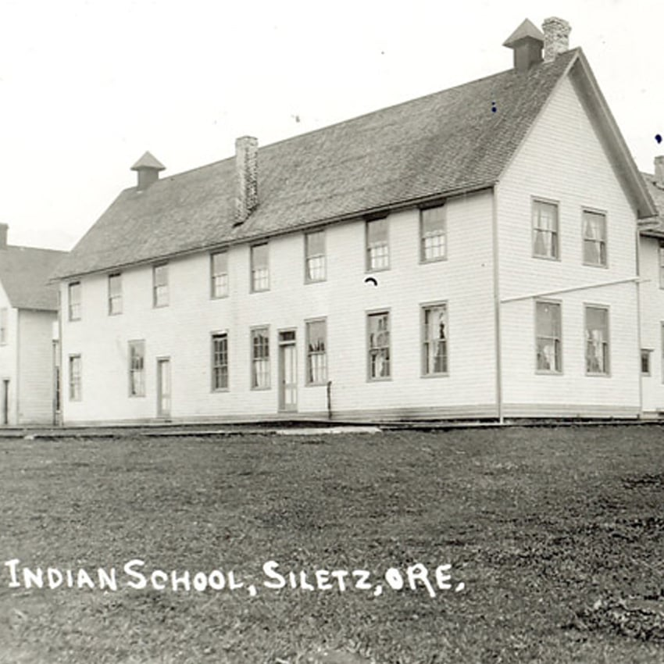
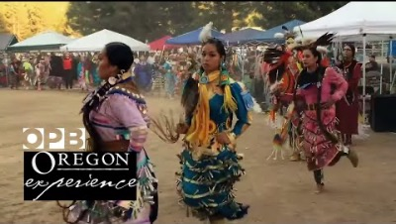
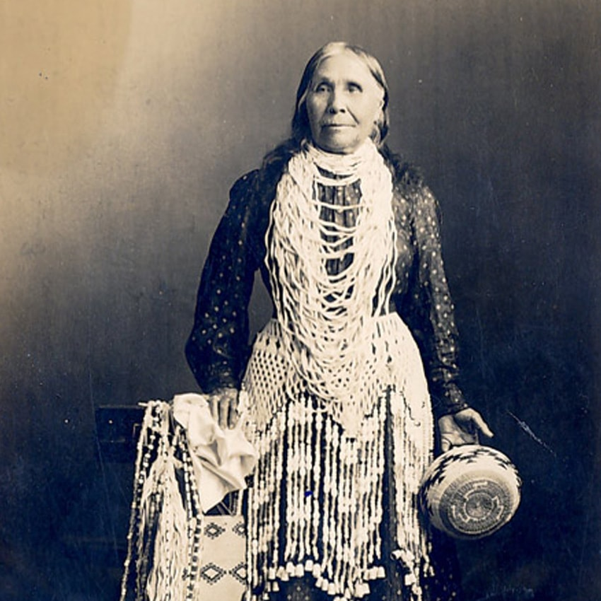
Land Acknowledgement
Today, descendants are citizens of the Confederated Tribes of Grand Ronde (rond) Community of Oregon and the Confederated Tribes of Siletz (suhLETZ) Indians of Oregon, and continue to make important contributions in their communities, at UO, across the land we now refer to as Oregon, and around the world.
https://www.grandronde.org/
https://www.ctsi.nsn.us/
OPB | Broken Treaties Documentary

Slide 4





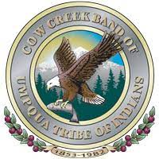

Land Acknowledgement
We express our respect for all federally recognized Tribal Nations of Oregon. This includes the Burns Paiute (PIE-yute) Tribe; the Confederated Tribes of the Coos, Lower Umpqua and Siuslaw Indians; the Confederated Tribes of the Grand Ronde Community of Oregon; the Confederated Tribes of Siletz Indians of Oregon; the Confederated Tribes of the Umatilla (Yu-ma-TILL-uh) Indian Reservation; the Confederated Tribes of Warm Springs; the Coquille (ko-KWELL) Indian Tribe; the Cow Creek Band of Umpqua Tribe of Indians; and the Klamath Tribes. We also express our respect for all other displaced Indigenous peoples who call Oregon home."
https://burnspaiute-nsn.gov/
https://ctuir.org/
https://ctclusi.org/
https://warmsprings-nsn.gov/
https://www.coquilletribe.org/
https://www.cowcreek-nsn.gov/
https://klamathtribes.org/

