Slide 1

TASK FORCE on usage of SAT/ACT in undergraduate admissions

Slide 2


Slide 3
Task Force Schedule:
February:
7th - Task Force kick-off meeting
10th - Statewide Counselor’s Advisory Board | invitation for members
12th - Initial Briefing for full Senate
14th - “Office Hours” | drop in for members
21st - Task Force Meeting
March:
10th - Deans Council
11th - Full Senate Briefing
16th - Board of Trustees Meeting
April:
1st - Senate Executive Committee
8th - Senate Vote of Agreement
TBD - President and Provost decision

Slide 4

The landscape for admissions is changing rapidly …
Test-optional admissions is about to grow dramatically

Slide 5
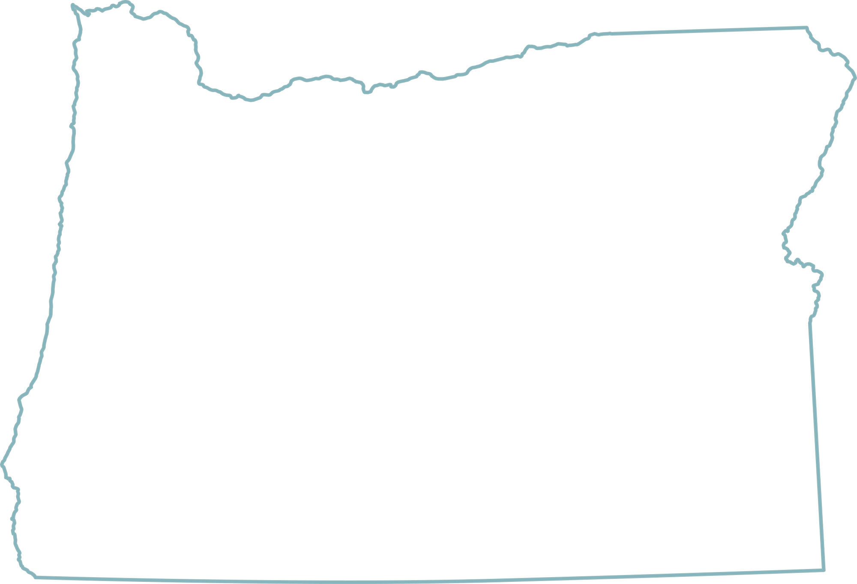
Test-optional policy in place at 13 Oregon institutions
PSU
EOU
Multnomah University
Pacific Northwest College of Art
Lewis & Clark
Pioneer Pacific College
Linfield
Mount Angel Seminary
Willamette
WOU
OSU-Cascades
public universities
New Hope Christian College
prominent private institutions
Oregon Tech
other private institutions

Slide 6



PAC 12
Washington
State
University
Arizona
State
University
University
of
Arizona
Other examples:
American University
Bates
Bowdoin
Brandeis
Colby
Colorado College
Connecticut College
DePaul
George Washington University
Indiana University*
NYU*
Rochester
Trinity (CT)
University of Chicago*
University of Denver
University of Texas-Austin*
Wake Forest
*AAU Members

Slide 7
Test scores have long been used as a
standardized measure in undergraduate admissions.
They provide some level of prediction of student outcomes in college, including first-year and cumulative grade point averages
Correlations between SAT scores and first year GPA average in the .40-.50 range
However, research has shown that scores from the SAT and ACT vary not just as a function of academic ability, but also in ways that reflect differences beyond a student’s control, including family income, parental education level, and race/ethnicity
While the tests are considered reliable, significant concerns about validity for some populations of students lead UO and other institutions across the country to reconsider their use.

Slide 8
College Board ACES Report, 2018 freshman class

Slide 9

Our current admissions practices
Holistic
Not rigidly reliant on test scores
Academic factors – grade trends, rigor, local context of school
Nonacademic factors - accomplishments, understanding of diversity and culture, resilience

Slide 10

Recommendations
Beginning effective with applicants fall 2021 freshman admission, move to traditional test-optional policy that allows:
Most applicants to have the choice of being considered for admission without test scores
Consideration for admission to UO overall, the Clark Honors College and the Lundquist College of Business Direct Admit program.

Slide 11
Exceptions
The following would still be required to submit scores:
Applicants whose high school curriculum includes study at an unaccredited school or homeschooled students
NCAA-recruited athletes
Other students who, on a case-by-case basis, were determined to need to submit scores as additional evidence of college readiness.

Slide 12

Implementation
All three versions of application will need content updated on the regular spring update schedule.
Banner and other internal systems will need to be updated for new process
Admissions reviewers and other scholarship/ admissions committees will need to be trained
Develop plans to communicate the change to both internal and external audiences
The University community – especially faculty and staff
All print and online resources aimed at prospective students/ families
High school counselors and administrators
The legislature
General public
Communication

Slide 13
GOALS
of a test-optional approach
Further grow diversity
Increase pool of considered applicants
Grow enrollment
Address issues of equity in admissions

Slide 14
In summary …
Based on review of relevant data, test-optional models, and potential benefits, we recommend the University of Oregon move to test-optional admissions.

