Slide 1
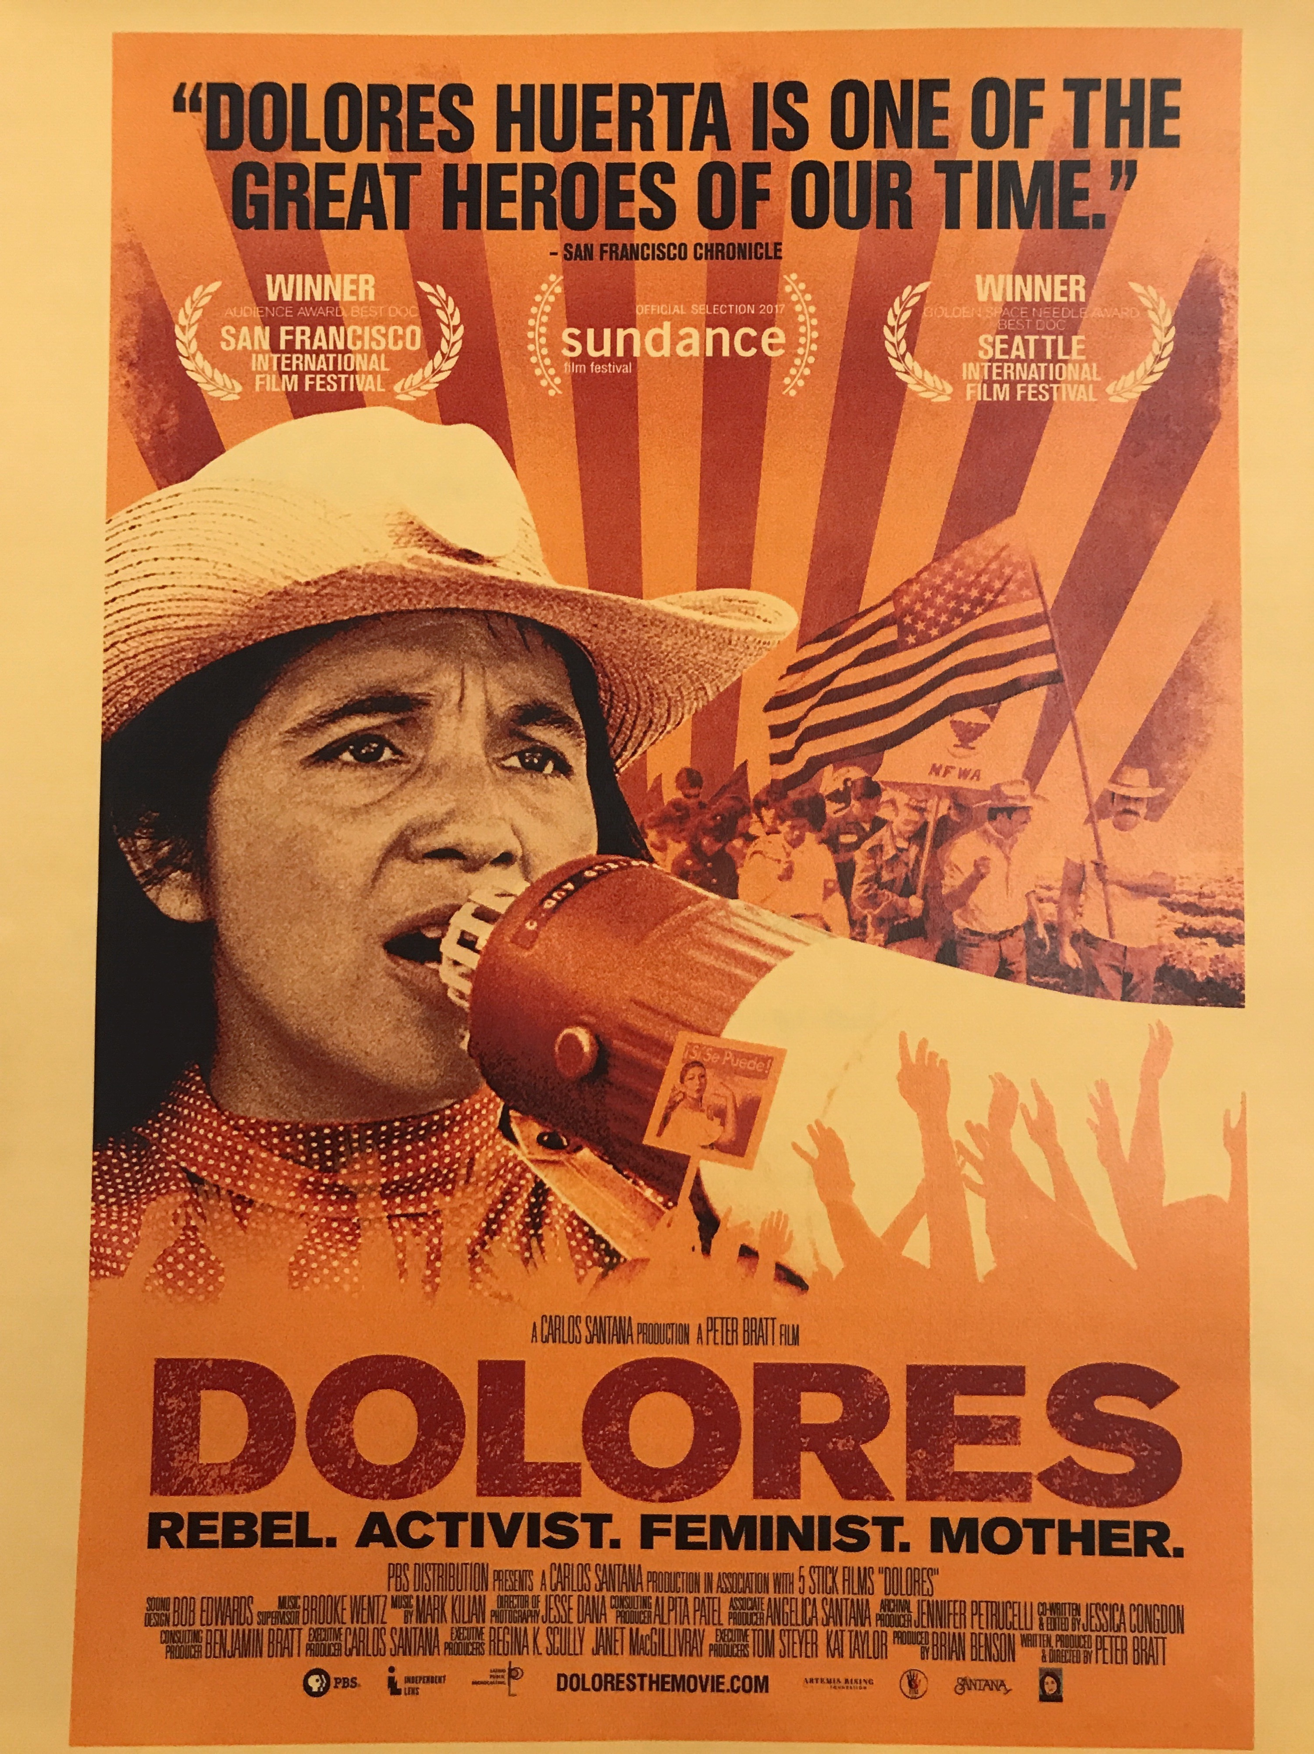
FILM SHOWING &
PANEL DISCUSSION
Film: 2:45pm at Broadway Metro Theatre, 43 W. Broadway, Eugene
Panel & Public Discussion:
“Plight of Oregon Migrant and Farm Workers”
4:30pm at the downtown Eugene Public Library
Bascom-Tykeson Room, 100 W 10th Ave, with
  Ramon Ramirez, Pineros y Campesinos Unidos
    del Noroeste (PCUN);
  Sandra Hernández-Lomelí, Director, Latinos
  Unidos Siempre (LUS);
  Philip Carrasco, Grupo Latino de Acción
  Directa of Lane County (GLAD);
  Lisa Arkin, Beyond Toxics
  http://www.beyondtoxics.org/events/dolores-documentary-showing-eugene/

