Slide 1
Concur/Travel Round Table
Concur New User Interface

Slide 2
Today’s Topics
Updates
Website facelift Fall 2023-updates and improvements ongoing https://ba.uoregon.edu/travel
Travel Office is reviewing reports 29 business days from receipt in Concur Processing Queue (after department approval)
New UI
Tips and Reminders
General Q and A

Slide 3
Why a new UI?
Accessibility
Same features and module (Request, Booking Tool, Expense) as current user interface, landing page and navigation are different (the black bar will be gone) and profile/delegate navigation is a little different
New UI will be turned on campus wide on December 18th
You can preview the New UI yourself prior to changeover

Slide 4
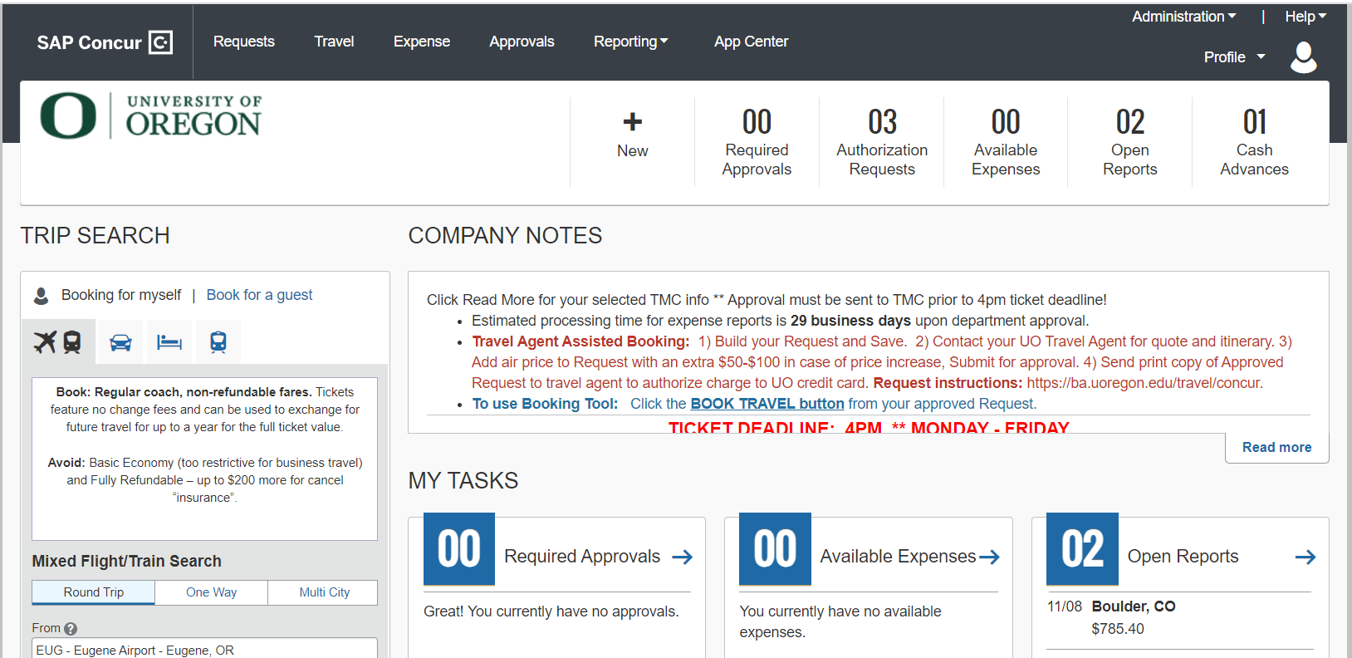
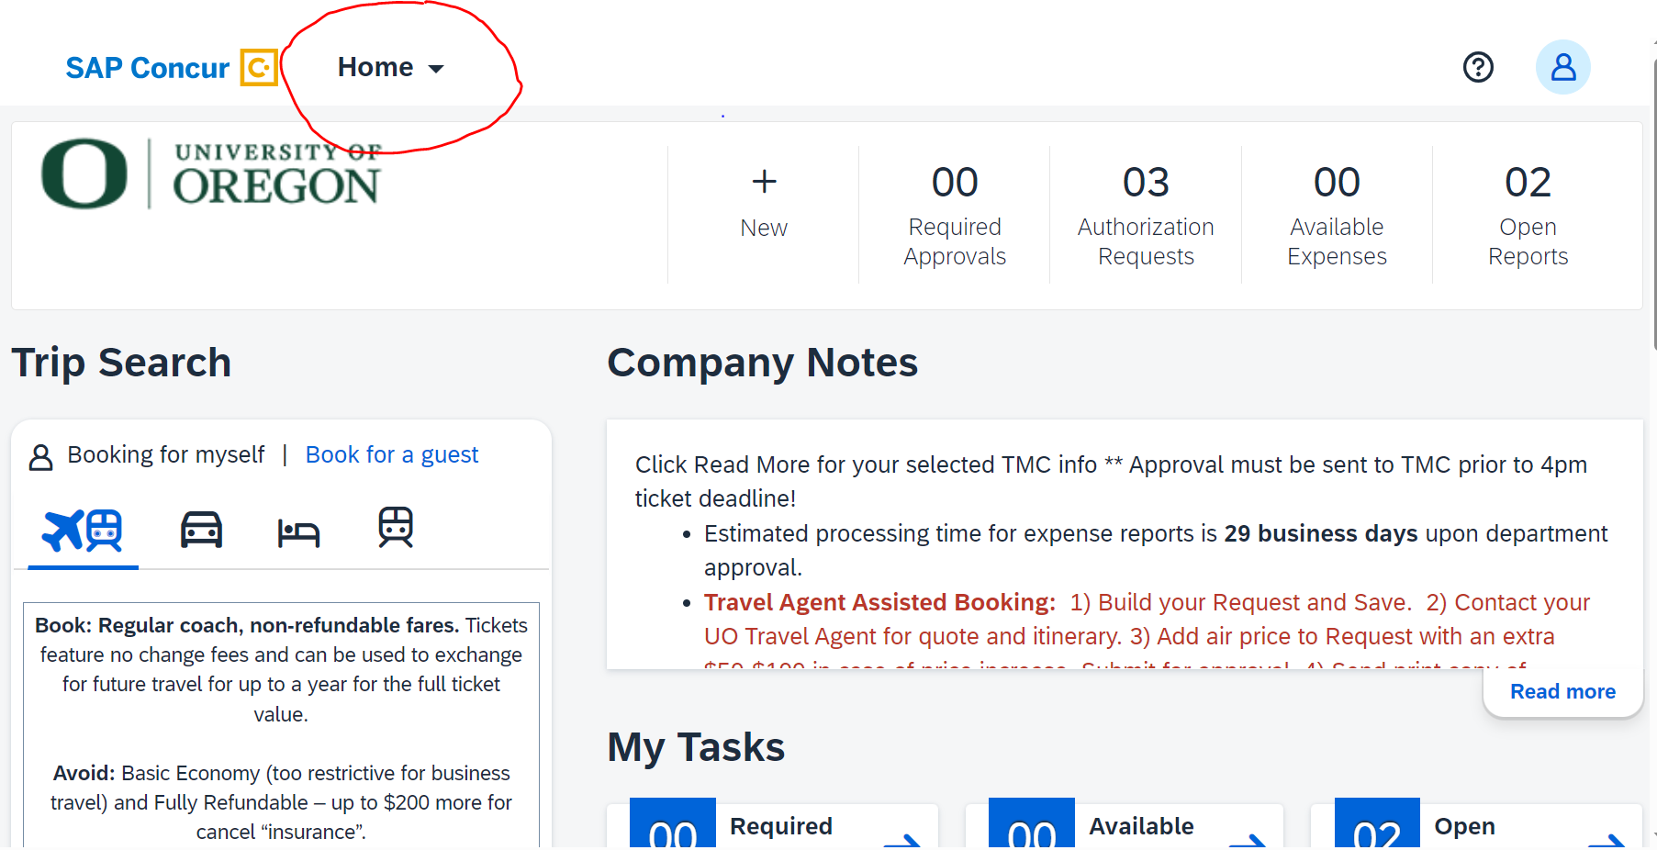
User Interface Comparison
Current (Legacy) UI
New (Fiori with Horizon) UI

Slide 5
A Brief Video Preview
https://dam.sap.com/mac/app/e/video/embed/zY5kL5j?ltr=a&rc=10&includeSapBrandedWraper=true

Slide 6
Previewing the SAP Fiori with Horizon Theme
Can I preview the SAP Fiori with Horizon visual theme before turning it on for my entire organization?
Yes, you can preview the SAP Fiori with Horizon visual theme on the web by following these instructions:
1.First, sign into SAP Concur solutions. (Concur.uoregon.edu)
2.If your entity is in the US (North America) datacenter, after signing into SAP Concur solutions, the URL you use to navigate to the Appearance Settings page is:
https://us2.concursolutions.com/Profile/AppearanceSettings.asp
3.After navigating to Appearance Settings, select the desired theme to preview and then click Apply Theme. The available themes are as follows: A. Concur Gateway b. Morning Horizon. Evening Horizon. In addition to the Horizon themes, you can enable High Contrast mode.
4.After clicking Apply Theme, the chosen theme is applied to the SAP Concur User interface until you sign out of SAP Concur solutions or until the theme is manually disabled.

Slide 7
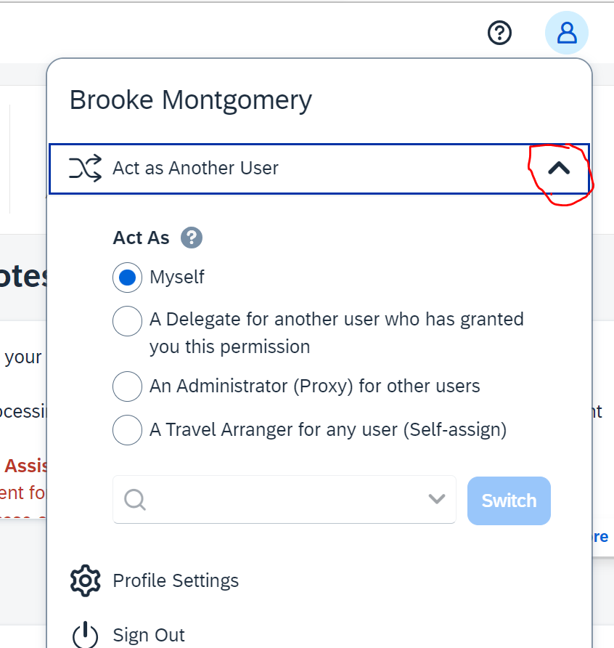
Let’s Look Around
Using preview URL
Black navigation bar has been replaced with Home drop down menu
Profile icon and Act as Another User
Request
Expense
Booking Tool

Slide 8
General Concur/Travel Tips
Holiday leave and delegate back up approvers
What to do when a receipt has been lost
Lodging
Name of Traveler, Dates Occupied, Nightly Rate, Demonstration of Payment
Confirmation, showing dates occupied, nightly rate, and total as well as Credit Card or Bank Statement showing the expense paid
Call/email hotel OR access through reward program account
Airfare
Name of Traveler, Ticket Number, Detailed Itinerary, Demonstration of Payment
Travel, Upcoming Trips or Trip Library
Direct Travel Tools-Receipts on Demand
Contact Premier for the receipt
Business Purpose Documentation
Conference agenda copy, please no URL’s and spell out acronyms
Launch Expense Report from Approved Request-Guidance from auditor and time saver for report Processors
Connect with the Travel Office when Request is Pending Online Booking or Closed Request
Assign a Travel Agency
Complete personal information in profile and verify uoregon.edu
Use service portal to assign approvers for Request and for Expense https://ba.uoregon.edu/travel/concur

Slide 9
Questions?

