Slide 1
University of Oregon
United Airlines Updates
Prepared for University of Oregon
October 26, 2022

Slide 2
United’s Route Network has you covered

Slide 3
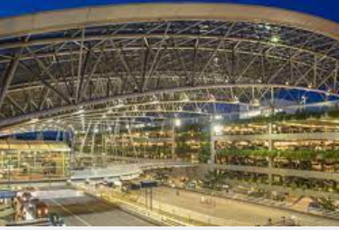
UNITED REGIONAL AIRPORTS
Portland International Airport
United has the Portland International Airport covered with non-stop service to all of its domestic hubs: San Francisco, Los Angeles, Denver, Chicago, Newark, Houston and Washington DC, making it possible to fly to any of United’s worldwide destinations with easy connections.
  5 daily flights to SFO
  5 daily flights to DEN
  3 daily flights to ORD
  2 daily flights to IAH
  1 daily flight to IAD
  1 daily flight to EWR
17
245
542
Average daily non-stop flights
International connection destinations
Domestic
connection destinations
Frequency and locations are subject to change.

Slide 4
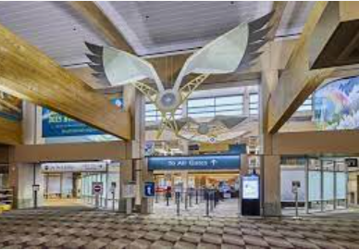
UNITED REGIONAL AIRPORTS
Eugene Airport
United serves University of Oregon’s hometown airport with daily flights to three of our international connecting hubs: SFO, DEN and LAX
From those hub locations United and United Express offer flights to 262 domestic destinations and 68 international destinations
  2 daily flights to SFO
  2 daily flights to DEN
  1 daily flight to LAX
5
68
265
Average Daily Nonstop flights
International connection destinations
Domestic connection destinations
Frequency and locations are subject to change.

Slide 5
Take advantage of more benefits while traveling on United

Slide 6


United Corporate Preferred
Exclusive benefits for business travelers
University of Oregon’s outstanding relationship with United® comes with United Corporate Preferred benefits. You’ll enjoy a full range of premium travel perks from booking to landing, and everything in between.
At the airport
Onboard
Travel flexibility
Enjoy higher priority on the standby list
Receive tie-breaker preference for upgrades
Rest easy with higher priority when travel doesn’t go as planned
Explore the benefits
See Terms and Conditions for eligibility requirements.

Slide 7


Travel is even more rewarding
with United’s award-winning program
#1 frequent flyer program 18 years running
Global Traveler
united.com/mileageplus

Slide 8

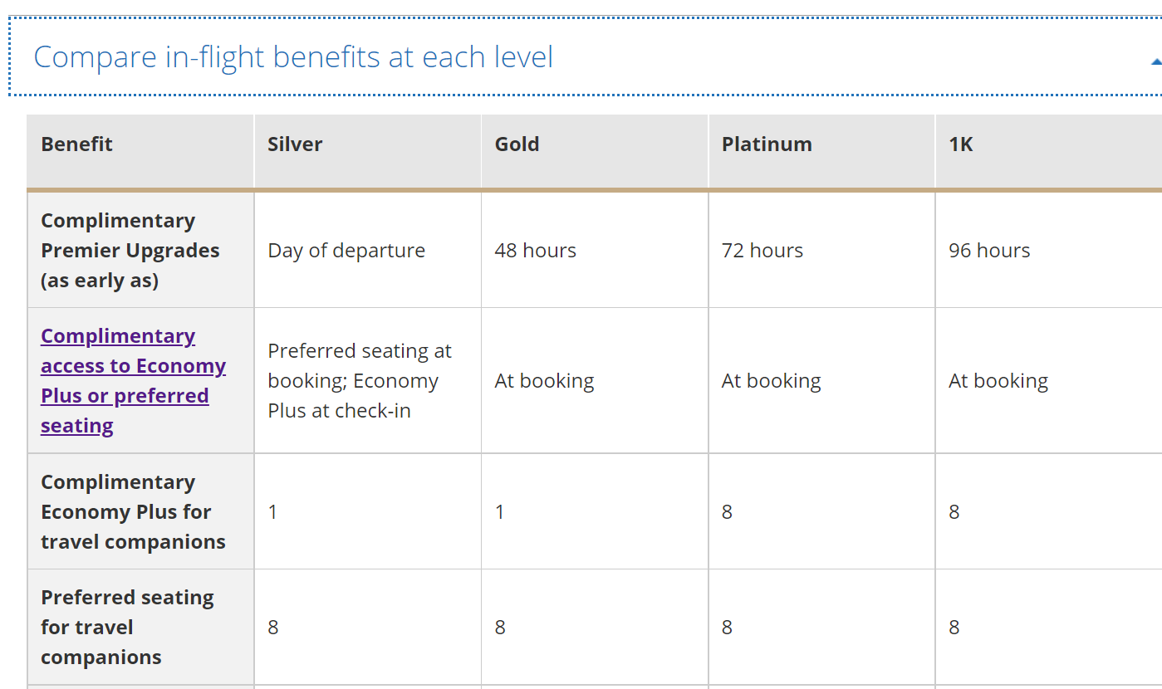



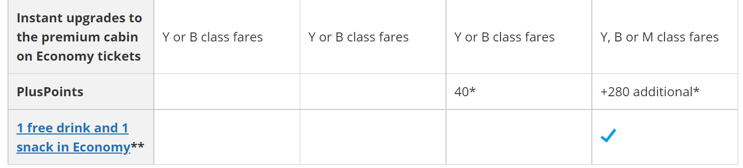
Elite Status Benefits
https://www.united.com/ual/en/us/fly/mileageplus/premier.html

Slide 9
United is making travel easier

Slide 10
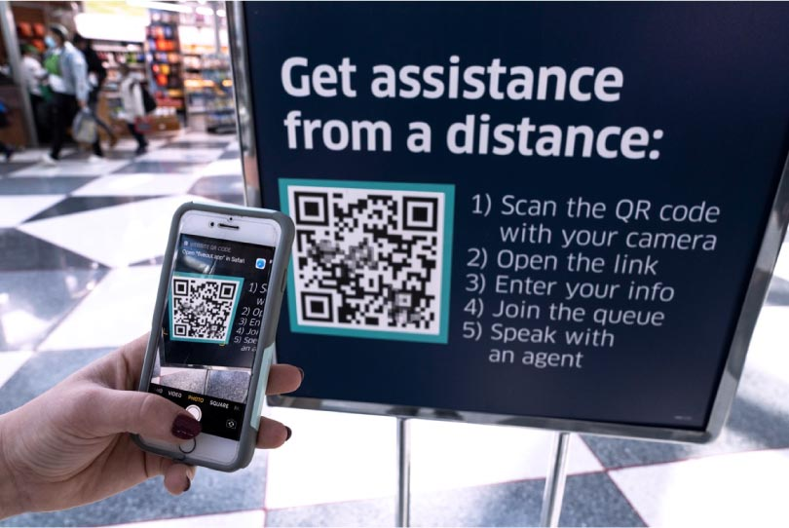
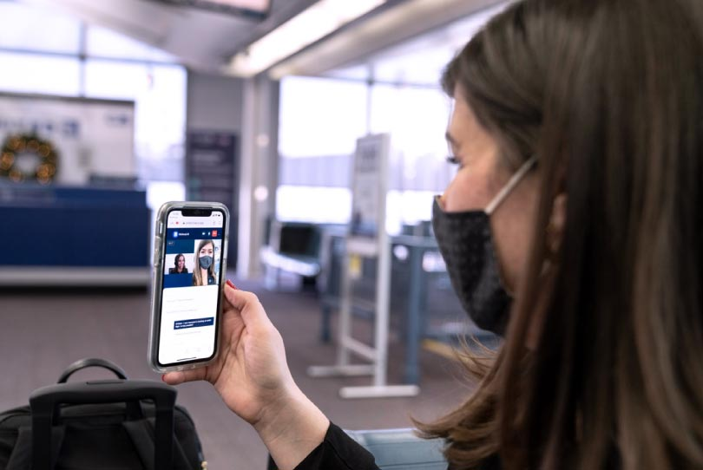

Contactless virtual assistance with “Agent on Demand”
Enjoy socially-distanced, personalized
support from our airport agents.
On the day of travel, our Agent on Demand service connects travelers to an airport customer service agent remotely through call, text or video chat.
Agent on Demand now includes personalized baggage support at all domestic airports so you can access contactless virtual assistance.
MileagePlus members:
Log into your MileagePlus account on your United App. Agent on Demand is available on the home page within 24 hours of your flight. Scroll down to “For your trip” and click on “Get connected”.
FACT FINDER
United is the first U.S. airline to launch video-enabled, day-of-travel customer service. Agent on Demand is currently available at over 100 airports including all seven of our hubs: Chicago (ORD), Denver (DEN), Houston (IAH), Los Angeles (LAX), Newark (EWR), San Francisco (SFO), and Washington, D.C. (IAD).
Get assistance
from a distance
Notes:
This is a great option for a socially-distant interaction or if the gate agent is busy with departure-critical tasks!

Slide 11


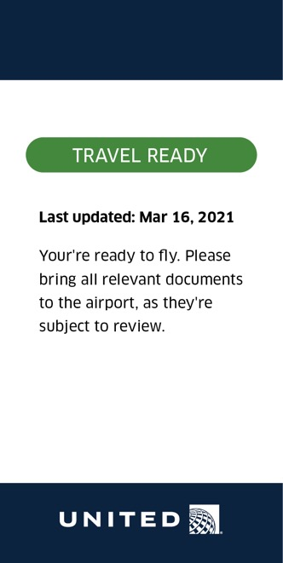
Ensure you’ve met all the local entry requirements for your destination with our Travel-Ready Center
After booking, enter your ticket info on united.com or in the United app.
Find requirements for a future trip in one place, including:
Up-to-date travel restrictions
COVID-19 testing requirements
Schedule a COVID-19 test*
Upload test results
*Not currently available in all countries

Slide 12
New technology makes connecting flights smoother
ConnectionSaver automatically scans flights for passengers who have tight connections to determine if the connecting flight can be held without inconveniencing other passengers.
Identifies flights that can be held
CASE STUDY
ConnectionSaver tested at
Denver and Chicago*
Ensures passengers already on board will arrive at their destinations on time
14,400
Customers that would have otherwise missed their connections were able to make their flights
Sends personalized texts to every connecting customer with info about their connection
6 minutes
Flights held for connecting customers were delayed an average of six minutes
Saves tight connections without inconvenience
*over a 4 month period starting in February 2019
Notes:
This ConnectionSaver technology will expand to the airline's hubs by this fall and to all other airports that United operates at in the future.

Slide 13


Enjoy even more flexibility when your company’s travel plans change
Visit “View all travel waivers” on the United Jetstream homepage for details.
No change fees for most Economy and premium cabin tickets for flights within the U.S. or between the U.S. and Mexico or the Caribbean.¹
No change fees for international travel originating in the U.S.
All customers may standby for an earlier flight on the same day for free.
MileagePlus® Premier® members may confirm a seat on an earlier flight for no cost at all.²
Free name changes for University of Oregon Travelers
¹ Basic Economy tickets are excluded.
² If the same fare class is available. If the same fare class is closed, a fare differential will apply. New flight must be within 24 hours of originally scheduled flight.
*All change fees are waived for tickets issued through March 31, 2021. View details at united.com/travel waivers.

Slide 14


Slide 15
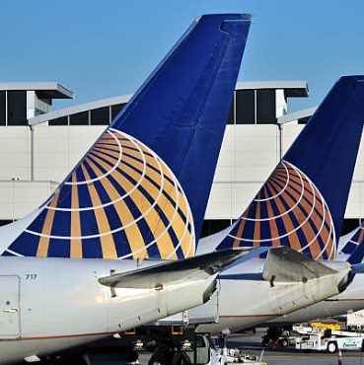
Appendix

Slide 16
INTERNATIONAL DESTINATIONS
Newark Liberty International Airport
Aguadilla, PR, US
Amsterdam, NL
Antigua, AG
Aruba, AW
Athens, GR
Barcelona, ES
Beijing, CN
Belize City, BZ
Bergen, NO
Berlin, DE
Bermuda, BM
Bogota, CO
Bonaire, BQ
Bridgetown, BB
Brussels, BE
Cancun, MX
Cape Town, ZA
Curacao, CW
Delhi, IN
Dublin, IE
Dubrovnik, HR
Edinburgh, SC, GB
Frankfurt, DE
Geneva, CH
Grand Cayman, KY
Guanacaste, CR
Guatemala City, GT
Havana, CU
Hong Kong, HK
Johannesburg, ZA
Lima, PE
Lisbon, PT
London-Heathrow, EN, GB
Madrid, ES
Mexico City, MX
Milan-Malpensa, IT
Montego Bay, JM
Montreal-PET, QC, CA
Mumbai, IN
Munich, DE
Naples, IT
Nassau, BS
Nice, FR
Ottawa, ON, CA
Palma de Mallorca, ES
Panama City, PA
Paris-De Gaulle, FR
Ponta Delgada, PT
Porto, PT
Providenciales, TC
Puerto Plata, DO
Puerto Vallarta, MX
Punta Cana, DO
Quebec, QC, CA
Reykjavik, IS
Rome-Da Vinci, IT
San Jose del Cabo, MX
San Jose, CR
San Juan, PR, US
San Pedro Sula, HN
San Salvador, SV
Santiago, DO
Santo Domingo, DO
Sao Paulo-Guarulhos, SP, BR
Shanghai, CN
Shannon, IE
St Thomas Island, VI, US
St. Kitts, KN
St. Lucia, LC
St. Maarten, SX
Tel Aviv-Yafo, IL
Tenerife-Reinasofia, ES
Tokyo-Haneda, JP
Tokyo-Narita, JP
Toronto, ON, CA
Vancouver, BC, CA
Venice, IT
Zurich, CH

Slide 17
INTERNATIONAL DESTINATIONS
Chicago O'Hare Airport
Amsterdam, NL
Aruba, AW
Beijing, CN
Belize City, BZ
Brussels, BE
Calgary, AB, CA
Cancun, MX
Cozumel, MX
Delhi, IN
Dublin, IE
Edinburgh, SC, GB
Frankfurt, DE
Grand Cayman, KY
Guanacaste, CR
Guatemala City, GT
Ixtapa/Zihuatanejo, MX
Leon/Guanajuato, MX
London-Heathrow, EN, GB
Mexico City, MX
Milan-Malpensa, IT
Montego Bay, JM
Monterrey, MX
Montreal-PET, QC, CA
Munich, DE
Nassau, BS
Ottawa, ON, CA
Paris-De Gaulle, FR
Providenciales, TC
Puerto Vallarta, MX
Punta Cana, DO
Reykjavik, IS
Rome-Da Vinci, IT
San Jose del Cabo, MX
San Jose, CR
San Juan, PR, US
Sao Paulo-Guarulhos, SP, BR
Shanghai, CN
St Thomas Island, VI, US
St. Lucia, LC
St. Maarten, SX
Tel Aviv-Yafo, IL
Tokyo-Haneda, JP
Toronto, ON, CA
Vancouver, BC, CA
Zurich, CH

Slide 18
INTERNATIONAL DESTINATIONS
Houston George Bush Intercontinental Airport
Acapulco, MX
Aguascalientes, MX
Amsterdam, NL
Aruba, AW
Belize City, BZ
Bogota, CO
Bonaire, BQ
Buenos Aires, BA, AR
Calgary, AB, CA
Cancun, MX
Comayagua, HN
Cozumel, MX
Frankfurt, DE
Grand Cayman, KY
Guadalajara, MX
Guanacaste, CR
Guatemala City, GT
Havana, CU
Ixtapa/Zihuatanejo, MX
Leon/Guanajuato, MX
Lima, PE
London-Heathrow, EN, GB
Manzanillo, MX
Mazatlan, MX
Merida, MX
Mexico City, MX
Montego Bay, JM
Monterrey, MX
Morelia, MX
Munich, DE
Nassau, BS
Oaxaca, MX
Panama City, PA
Port of Spain, TT
Providenciales, TC
Puebla, MX
Puerto Vallarta, MX
Punta Cana, DO
Queretaro, MX
Quito, EC
Rio De Janeiro, RJ, BR
Roatan, HN
San Jose del Cabo, MX
San Jose, CR
San Juan, PR, US
San Luis Potosi, MX
San Pedro Sula, HN
San Salvador, SV
Santiago, CL
Sao Paulo-Guarulhos, SP, BR
St Thomas Island, VI, US
Sydney, NS, AU
Tampico, MX
Tokyo-Narita, JP
Toronto, ON, CA
Vancouver, BC, CA
Veracruz, MX

Slide 19
INTERNATIONAL DESTINATIONS
San Francisco International Airport
Amsterdam, NL
Auckland, NZ
Beijing, CN
Bengaluru, IN
Brisbane, QL, AU
Calgary, AB, CA
Cancun, MX
Chengdu, CN
Delhi, IN
Frankfurt, DE
Guanacaste, CR
Hong Kong, HK
London-Heathrow, EN, GB
Melbourne, VI, AU
Mexico City, MX
Munich, DE
Osaka-Kansai, JP
Paris-De Gaulle, FR
Puerto Vallarta, MX
San Jose del Cabo, MX
Seoul, KR
Shanghai, CN
Singapore, SG
Sydney, NS, AU
Tahiti, PF
Taipei, TW
Tel Aviv-Yafo, IL
Tokyo-Haneda, JP
Tokyo-Narita, JP
Toronto, ON, CA
Vancouver, BC, CA
Zurich, CH

Slide 20
INTERNATIONAL DESTINATIONS
Los Angeles International Airport
Belize City, BZ
Cancun, MX
Cozumel, MX
Guanacaste, CR
Guatemala City, GT
Ixtapa/Zihuatanejo, MX
London-Heathrow, EN, GB
Manzanillo, MX
Melbourne, VI, AU
Puerto Vallarta, MX
San Jose del Cabo, MX
San Jose, CR
San Pedro Sula, HN
San Salvador, SV
Shanghai, CN
Sydney, NS, AU
Tokyo-Haneda, JP
Tokyo-Narita, JP
Vancouver, BC, CA

Slide 21
INTERNATIONAL DESTINATIONS
Denver International Airport
Belize City, BZ
Calgary, AB, CA
Cancun, MX
Cozumel, MX
Edmonton, AB, CA
Frankfurt, DE
Guanacaste, CR
London-Heathrow, EN, GB
Munich, DE
Nassau, BS
Puerto Vallarta, MX
Roatan, HN
San Jose del Cabo, MX
San Jose, CR
Tokyo-Narita, JP
Toronto, ON, CA
Vancouver, BC, CA

Slide 22
INTERNATIONAL DESTINATIONS
Washington Dulles International Airport
Accra, GH
Amman, JO
Amsterdam, NL
Aruba, AW
Athens, GR
Barcelona, ES
Beijing, CN
Bridgetown, BB
Brussels, BE
Cancun, MX
Cape Town, ZA
Dublin, IE
Edinburgh, SC, GB
Frankfurt, DE
Geneva, CH
Grand Cayman, KY
Guatemala City, GT
Lagos, NG
Lisbon, PT
London-Heathrow, EN, GB
Madrid, ES
Mexico City, MX
Montego Bay, JM
Montreal-PET, QC, CA
Munich, DE
Nassau, BS
Ottawa, ON, CA
Paris-De Gaulle, FR
Providenciales, TC
Punta Cana, DO
Rome-Da Vinci, IT
San Jose, CR
San Juan, PR, US
San Salvador, SV
Santo Domingo, DO
Sao Paulo-Guarulhos, SP, BR
St Thomas Island, VI, US
St. Maarten, SX
Tel Aviv-Yafo, IL
Tokyo-Haneda, JP
Toronto, ON, CA
Zurich, CH

Slide 23
Thank you!
We appreciate your business.

