Slide 1
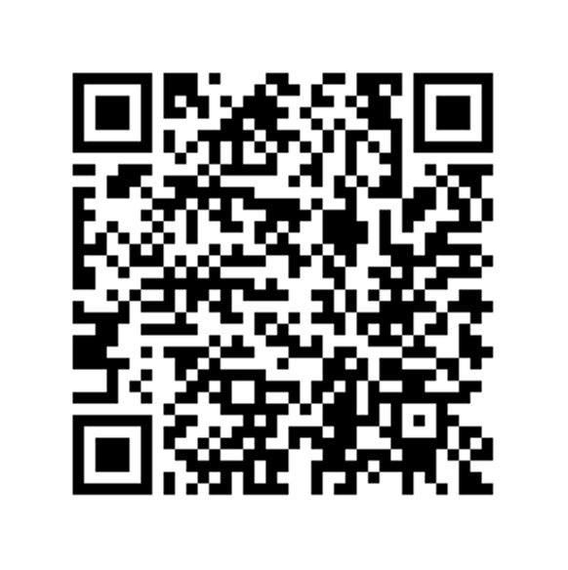
Become a Peer Wellness Facilitator at the Duck Nest!
PWFs are student volunteers who work weekly shifts in the Duck Nest Wellness Center (EMU 041) and facilitate programming to peers on a variety of health and wellness topics
Applications close Wednesday, February 8th at 5pm
Apply now!
This application can also be found on our website: health.uoregon.edu/ducknest
bit.ly/applypwf
Notes:
Interested in joining our amazing team of Peer Wellness Facilitators? We will begin recruiting new volunteers Winter term. Scan this QR code to sign up to receive recruitment information, or stop by the Duck Nest and ask us about volunteering!

