Slide 1
School-based Violence & Bullying Prevention:
Narrowing the research-to-practice gap
Dorothy L. Espelage, Ph.D.
Professor of Psychology
espelage@ufl.edu
Website: http://www.psych.ufl.edu/espelage/
Twitter: DrDotEspelage

Slide 2
Funding Sources & Disclaimer
Research was supported by Centers for Disease Control & Prevention (#1U01/CE001677) to Dorothy Espelage (PI); Opinions, findings, and conclusions or recommendations expressed in this presentation are those of the author(s) and do not necessarily reflect those of the CDC
Research was supported by NIJ Grant (MUOFX-0022) to Dorothy Espelage (PI) & Sabina Low (co-PI); Opinions, findings, and conclusions or recommendations expressed in this presentation are those of the author(s) and do not necessarily reflect those of the Department of Justice

Slide 3
Espelage Research Lab
  SOCIAL-ECOLOGY & SCHOOL-BASED PREVENTION (Espelage & Swearer, 2003; Espelage, 2012, 2014, 2016)
  EXPOSURE TO VIOLENCE STUDY (Espelage, 1998; Low & Espelage, 2014)
  SOCIAL NETWORK ANALYSIS STUDY (Birkettt & Espelage, 2014; Espelage, Holt, & Henkel, 2003; Espelage, Green, & Wasserman, 2007; Espelage, Green, & Polanin, 2012; Tucker et al., 2016, Merrin et al., in press)
  SEXUAL HARASSMENT, DATING VIOLENCE, & BULLYING STUDIES (Holt & Espelage, 2003; Holt & Espelage, 2005; Espelage & Holt, 2006; Espelage, Basile, & Hambuger, 2012, 2014, 2016)
  THEORY OF MIND, EMPATHY, & PEER RELATIONS (Espelage et al., 2004; Mayberry & Espelage, 2006; Espelage et al. 2016)
  SEXUAL VIOLENCE, & BULLYING (Poteat & Espelage, 2006; Espelage et al., 2008; Espelage et al., 2012; 2014, 2017)
  YOUTH & MENTAL HEALTH OUTCOMES (Espelage, Aragon, Birkett, & Koenig, 2008; Poteat, Espelage, & Koenig, 2009; Birkett, Espelage, & Koenig, 2009; Robinson & Espelage, 2012, 2013)
  STUDENTS WITH DISABILITIES - Victimization & Psychological Correlates & SEL prevention (Rose et al., 2010; Rose & Espelage, 2012; Espelage, Rose, & Polanin, 2015, 2916)
  SCHOOL CLIMATE, ACADEMIC ENGAGEMENT (Espelage et al., 2014, 2015)

Slide 4
Espelage Mantra:
With Awareness Comes Misperception
Misperception in Media Scientific Evidence
-Bullying is an epidemic. -Bully Rates Vary
-Bully-suicide linked. -Bully Only One of Many Predictors
-Bully are young criminals. -Bullies are diverse in their outcomes
-Bullies need to be punished. -Ignores Group Phenomena
-Bullies – dysfunctional families -Good kids get involved in bullying
-Bullying is hard-wired in youth -Environment matters – gene expression

Slide 5
Definition of Bullying
(CDC; Gladden et al., 2014)
Bullying is unwanted aggressive behavior(s) among school-age children that has a high likelihood of causing physical or psychological harm or injury and is characterized by:
1) an imbalance of real or perceived power that favors the aggressor(s);
2) is repeated or has a high likelihood of being repeated;
3)The victim(s) of bullying may feel intimidated, demeaned, or humiliated as a result of the aggression.

Slide 6
Components Matter
(Ybarra, Espelage, & Mitchell, 2014; JAH)
Nationally-representative samples: (1) 2008: 1,157 12- to 17-year-olds; (2) 2010-11: 3,989 13- to 18-year-olds.
Youth who reported neither differential power nor repetition had the lowest rates of interference with daily functioning.
Youth who reported either differential power or repetition had higher rates.
Highest rates of interference with daily functioning were observed among youth who reported both differential power and repetition; these youth report highest level of helplessness.
Youth were victims of online generalized peer aggression (30%) or both online generalized peer aggression and cyberbullying (16%) but rarely cyberbullying alone (1%).

Slide 7
Bullying Prevalence
Among 3rd – 8th graders:
  15% Chronically Victimized
  17% Ringleader Bullies
  8% Bully-Victims
  60% Bystanders
    Only 13% intervene to help victim
        (Espelage, 2015)

Slide 8
Definition of Cyber-Bullying
(Hinduja & Patchin, 2009)
Cyberbullying is defined as “willful and repeated harm inflicted through the use of computers, cell phone, or other electronic devices” (p. 5).
Utilizing technology, youth can send or post humiliating or threatening messages or photos of their targets to a third party or to a public forum where many online participants visit (Hinduja & Patchin, 2009).

Slide 9
Cyber-Bullying Prevalence
7% of students in U.S. public schools nationwide reported being cyberbullied in 2013 (Zhang, Musu-Gillette, & Oudekerk, 2016).
Rate of cyberbullying is lower than the rate of face-to-face bullying victimization (22%),
Cyberbullied students were less likely to notify an adult than face-to-face bullying victims (23% vs. 39%; Zhang et al., 2016).
Review of cyberbullying literature by the rate to be anywhere between 4% and 78% (Aboujaoude, Savage, Starcevic, & Salame, 2015).

Slide 10
Transactional Associations
Between School-Based
Aggression/Bullying & Cyberbullying
This research was supported by Centers for Disease Control & Prevention (#1U01/CE001677) to Dorothy Espelage (PI)

Slide 11
Method
Participants
  1,132 students (49.1% female)
  3 cohorts (5th, 6th, 7th graders)
  Assessed across 4 waves including Spring/Fall 2008, Spring/Fall 2009
  Racially diverse (51% Black; 34% White;
  3% Hispanic; 3% Asian; 9% Other)

Slide 12
Bullying Perpetration & Cyberbullying Perpetration
Espelage, Rao, & Craven, 2013
Notes:
Longitudinal structural equation modeling was used to examine longitudinal associations between face-to-face and cyberbullying perpetration. An item-to-construct balance method was used to develop parcels for both the scales (Little et al., 2002). The measurement model was established and strong factorial invariance was demonstrated. The structural model that was then imposed provided good ﬁt to the data, χ² _{(219, n=1132)}= 945.318; RMSEA = 0.0542 _{(0.0506 ; 0.0577)}; NNFI = .0975; CFI = 0.980. The results of the model tested are shown in Figure 1.
These results indicated that higher bullying perpetration at an earlier time point was predictive of increases in cyberbullying perpetration in consecutive time points (after controlling for previous cyberbullying behaviors). Engagement in cyberbullying perpetration did not predict increases in traditional bullying in our data. These results support our hypothesis that bullying perpetration is an antecedent of cyberbullying perpetration in middle school. Findings from this study provide strong support for the link between bullying perpetration and cyberbullying perpetration among a large sample of young adolescents. Bullying perpetration emerged as a precursor to cyberbullying perpetration across 2 years and 4 waves of survey data. This study suggests that cyberbullying may be an extension of other bullying behaviors. It is possible that as children get older and increase their engagement with technology, cyberspace becomes another context within which bullying perpetration occurs. Given the substantial predictive power of face-to-face bullying to cyberbullying, bullying prevention programs need to consider how face-to-face encounters in school might spill over into cyberspace where adult monitoring and intervention is relatively absent.

Slide 13
Bullying Victimization and Cyberbullying Perpetration
Espelage, Rao, & Craven, 2013
Notes:
The structural provided good ﬁt to the data χ² _{(222, n=1132)}= 854.147; RMSEA = 0.0486 _{(0.0453 ; 0.0525)}; NNFI = .0965; CFI = 0.972. Results shown in Figure 2, indicate a transactional model, with predictive cross-lagged coefficients across the four waves. This suggests that peer victimization and cyberbullying perpetration operate within a reciprocal influence model. This provides support for both theories, although, initially cyberbullying perpetration predicts peer victimization. It is possible that when youth who do not have status in face-to-face contexts engage in cyberbullying, it puts them at particular risk for peer victimization, which in turn causes them to retaliate in the more removed, safe, cyber space.

Slide 14
Bullying Perpetration & Sexual Violence Perpetration Among Middle School Students: Gender-Based Bias Matters
Dorothy L. Espelage, Ph.D.
University of Florida
Lisa De La Rue, Ph.D.
University of San Francisco
&
Kathleen C. Basile, Ph.D.
Division of Violence Prevention
Centers for Disease Control & Prevention, Atlanta, Georgia
Merle E. Hamburger, Ph.D.
Journal of Adolescent Health (2012), Journal of Interpersonal Violence (2014)
This research was supported by Centers for Disease Control & Prevention
(#1u01/ce001677) to Dorothy Espelage (PI)
Notes:
Short talk
Quickly go through what's going on …usage, rates, etc.
And then provide some practical tips that parents can use
No Kinda

Slide 15
Study Participants
Demographics:
  1,650 students (49.1% female)
  3 cohorts (5th, 6th, 7th graders)
  Racially diverse (51% Black, 34% White)
  60% Free/reduced lunch
  7 waves of data collection
  (from spring 2008-spring 2013)

Slide 16
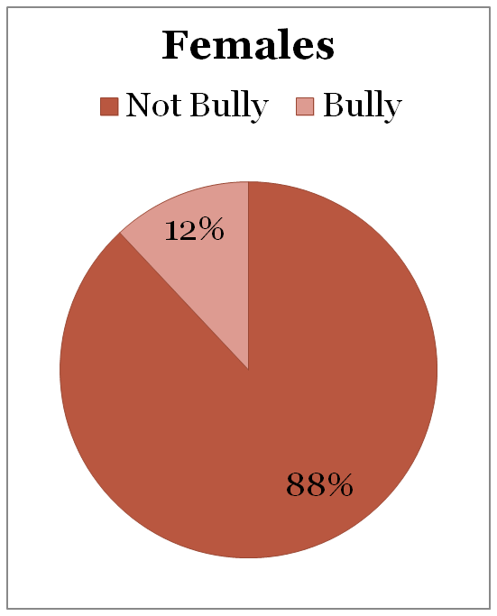
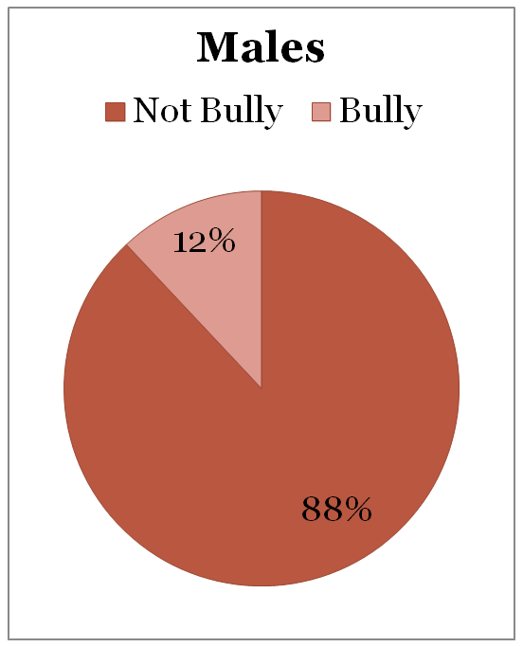
Percentages of Youth who Bully

Slide 17
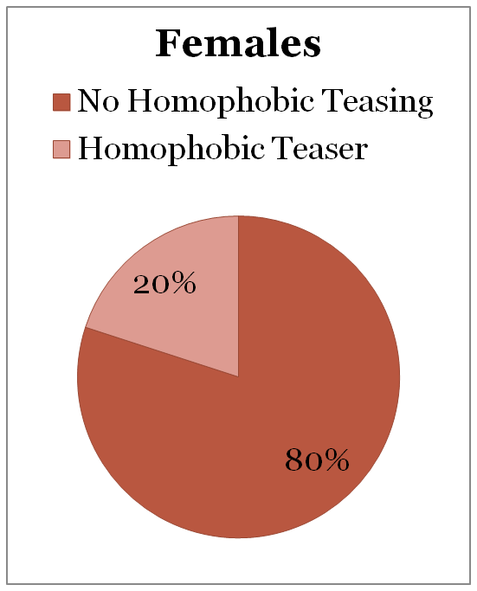
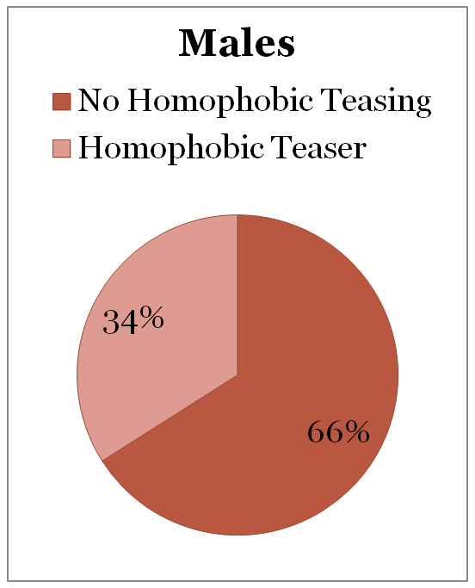
Percentages of Youth Who Engage in Homophobic Name-Calling

Slide 18
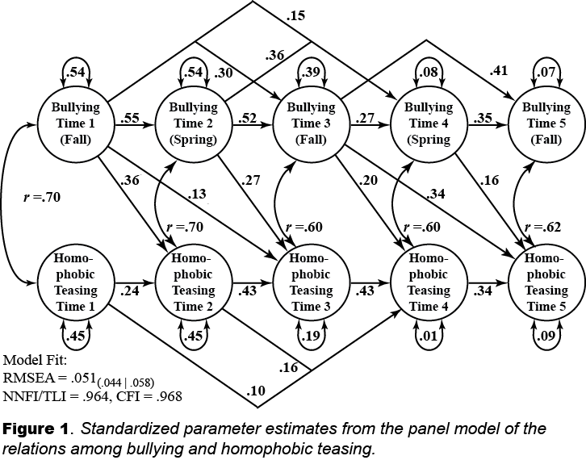
Bullying – Homophobic Teasing Perpetration
(Espelage et al., 2016; Little, 2013)

Slide 19
Take-Away Messages
Homophobic name-calling is prevalent in middle school (Meyer, 2009, 2010).
Youth who bully resort to homophobic name-calling over the middle school years.
Bully prevention programs should include a discussion of language that marginalizes gender non-conforming and lesbian, gay, bisexual (LGB) youth.

Slide 20
Bully-Sexual Violence Pathway
Bullying
Perpetration
Wave 1
+
+
Sexual Harassment
Perpetration
Wave 2 (5) (7)
Homophobic Teasing
Perpetration
Wave 1
+
+
Controlling for:
Sexual Harassment
Perpetration
Wave 1
+
(Espelage, Basile, & Hamburger, 2012; Espelage, Basile, & De La Rue, 2014
Espelage et al., in press)

Slide 21
Take-Away Messages
Strong longitudinal associations among bullying, homophobic bantering, and sexual harassment perpetration from early to late adolescence.
For boys, bullying sexual violence link moderated by homophobic name-calling (Espelage et al., 2014; under review)

Slide 22
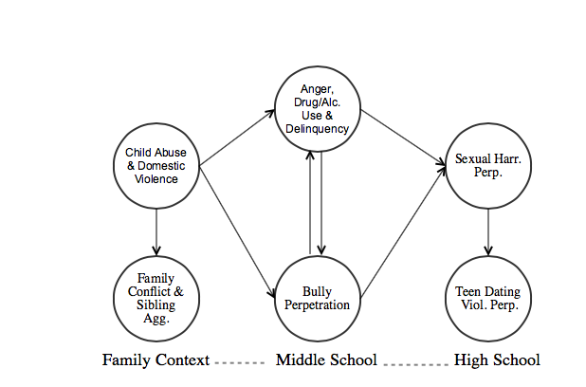
Developmental model of bullying, sexual harassment and dating violence
Model Fit:
RMSEA = .07 (.06-.08)
NIJ Grant (MUOFX-0022) to Dorothy Espelage (PI)
Espelage, Low, Anderson, & De La Rue, 2014

Slide 23
Implications for Prevention
Research must consider multiple contexts to identify longitudinal predictors, mediators, moderators associated with outcomes for youth who bully and later forms of violence.
Bullying programs need to incorporate discussion of gender-based name-calling, sexual violence, and gender expression (homophobic language; Birkett & Espelage, 2010; Meyer, 2009, 2010; Espelage, 2016).

Slide 24
Social-Ecological Perspective
Society
Community
School
/Peers
Family
Child
(Bronfenbrenner, 1979; Espelage & Horne, 2007; Espelage, 2014)

Slide 25
Individual Correlates of Bullying Involvement
Depression/Anxiety
Empathy
Delinquency
Impulsivity
Other forms of Aggression
Alcohol/Drug Use
Positive Attitudes toward Violence/Bullying
Low Value for Prosocial Behaviors
  For review (Espelage & Horne, 2007; Espelage & Holt, 2012)

Slide 26
Family & School Risk Factors
FAMILY
  Lack of supervision
  Lack of attachment
  Negative, critical relationships
  Lack of discipline/ consequences
  Support for violence
  Modeling of violence
SCHOOL
  Lack of supervision
  Lack of attachment
  Negative, critical relationships
  Lack of discipline/ consequences
  Support for violence
  Modeling of violence
  For review (Espelage, 2012; Espelage & Horne, 2007)

Slide 27
Social Network Studies: Peers Matter
Homophily hypothesis supported in social network studies – early adolescence:
Bully perpetration – selection & socialization (Espelage et al. 2003; Merrin et al., in press)
Homophobic name-naming/Sexual harassment – selection & socialization (Poteat, Espelage, & Green, 2007; Tucker et al., 2016)
Willingness to Intervene – socialization (Espelage, Green, & Polanin, 2012)

Slide 28
Longitudinal Family X Peer Influences
Within-person peer deviance varied as a function of between-person family violence on individual rates of bullying perpetration over two years of middle school.
A significant cross-level interaction indicated that individuals with higher average rates of family violence had significantly higher rates of bullying perpetration, even at low levels of within-person peer deviance.
As within-person peer deviance increased, rates of bullying perpetration were exacerbated particularly for individuals in the high between-person family violence group (+1 standard deviation).
(Grant, Merrin, King, & Espelage, in press)

Slide 29
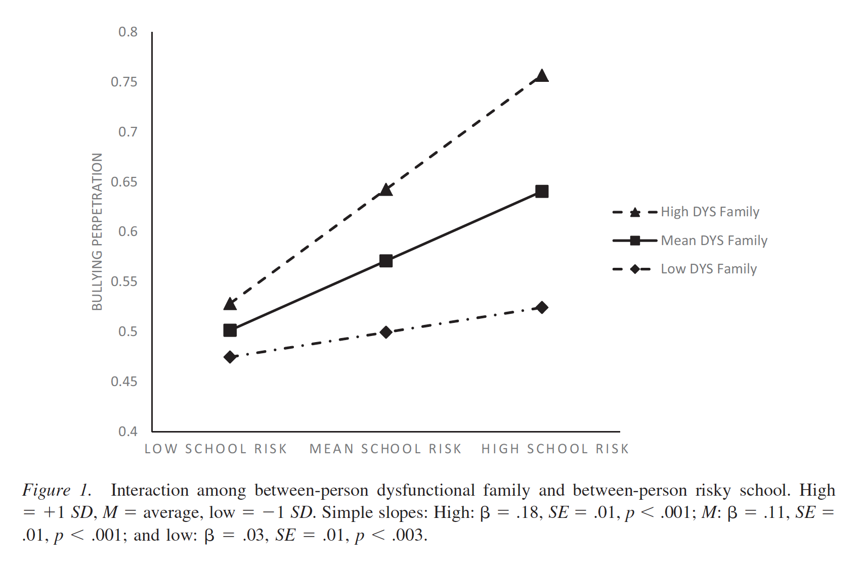
Family X School Interactions
(Merrin, Espelage, & Hong, 2016)

Slide 30
Meta-Analytic Study
Cook, Williams, Guerra, Kim, & Sadek (2010)
  Reviewed 153 studies since 1970
  Youth who bully other students: have significant externalizing behavior, social competence and academic challenges, negative attitudes toward others, family characterized by conflict
  Peer Status & Bully varied by age: Adolescents who bully have higher peer status than children who bully others

Slide 31
Bystander Interventions
(Polanin, Espelage, & Pigott, 2011)
Meta-analysis synthesized the effectiveness of bullying prevention programs in altering bystander behavior to intervene in bullying situations.
Evidence from twelve school-based interventions, involving 12,874 students, revealed that overall the programs were successful (ES = .21, C.I.: .12, .30), with larger effects for high school samples compared to K-8 student samples (HS ES = .44, K-8 ES = .13; p = .001).
Analysis of empathy for the victim revealed treatment effectiveness that was positive but not significantly different from zero (ES = .05, CI: -.07, .17).
Nevertheless, this meta-analysis indicated that programs were effective at changing bystander behavior both on a practical and statistically significant level.

Slide 32
Bystander Interventions
(Polanin, Espelage, & Pigott, 2011)

Slide 33
Rethinking Bystander Interventions
Need to consider the following when considering a bystander intervention:
  Age of target population
  Gender of target population
  Peer/adult norms around intervention: Including In-group and out-group norms, justification for bullying
  Level of bullying and peer victimization experiences in the school
  Length of intervention & who to deliver
  Components of intervention (behavioral modification, modeling with media, awareness raising, parent training)

Slide 34
Developmental Lens
Meta-Analysis:
Yeager, Fong, Lee, &
Espelage (2015)

Slide 35
Bullying Prevention –
Pushing The Field Forward
Bullying co-occurs with other types of aggression and other risky behavior (delinquency, AOD).
Overlapping risk and protective factors need to be targeted in school-based programs in order to address spectrum of problem behavior (Cataliano et al., 2002).
Need to consider interventions that target multiple forms of violence and aggression that are salient for early adolescents, including peer victimization, homophobic teasing, and sexual harassment/violence (Espelage, Basile, & Hamburger, 2012; Hamby & Grych, 2013)

Slide 36
Social-Emotional Learning (SEL)
SEL focuses on the systematic development of a core set of social and emotional skills that help youth more effectively handle life challenges, make better decisions, and thrive in both their learning and their social environments through a climate that supports the practicing of skills.
A meta-analysis of 213 programs found that if a school implements a quality SEL curriculum, they can expect better student behavior and an 11 percentile increase in test scores (Durlak, Weissberg, Dymnicki, Taylor, & Schellinger, 2011).

Slide 37
MULTI-SITE EVALUATION OF SECOND STEP:
STUDENT SUCCESS THROUGH PREVENTION
(SECOND STEP – SSTP)
IN PREVENTING AGGRESSION, BULLYING, & SEXUAL VIOLENCE
Dorothy L. Espelage, Ph.D.
Professor, Psychology,
University of Florida
Sabina Low, Ph.D.,
Arizona State University
Josh Polanin, M.A., DSG
Eric Brown, Ph.D., University of Miami
Journal of Adolescent Health (2013), Journal of Applied Developmental Psychology (2015);
School Psychology Review (2015)
Research supported by Centers for Disease Control & Prevention (#1U01/CE001677)

Slide 38

Committee for Children, 2008
Notes:
Program design was driven by client requests and market demands.
Committee for Children had numerous requests for a bullying program for this age group and there is a clear need to address substance abuse at this age.
A thorough market review indicated that schools and districts don’t have the time and resources to be teaching multiple prevention programs. In the academic climate in the United States, schools have a hard time doing prevention and social emotional learning programs at all. They want one program that covers it all.

Slide 39
Social-Emotional Learning
Goal 1: Develop self-awareness and self-management skills to achieve school and life success.
  Identify and manage one’s emotions and behavior.
  Recognize personal qualities and external supports.
  Demonstrate skills related to achieving personal and academic goals.

Slide 40
Social-Emotional Learning
Goal 2: Use social-awareness and interpersonal skills to establish and maintain positive relationships.
  Recognize the feelings and perspectives of others.
  Recognize individual and group similarities and differences.
  Use communication and social skills to interact effectively with others.
  Demonstrate an ability to prevent, manage, and resolve interpersonal conflicts in constructive ways.

Slide 41
Social-Emotional Learning
Goal 3: Demonstrate decision-making skills and responsible behaviors in personal, school, and community contexts.
  Consider ethical, safety, and societal factors in making decisions.
  Apply decision-making skills to deal responsibly with daily academic and social situations.
  Contribute to the well-being of one’s school and community.

Slide 42
Program Goals
Research Foundations
  Risk and Protective Factors
  Bullying
  Brain Research
  Positive Approaches to Problem Behavior
  Developmental Needs of Young Adolescents
Notes:
We’ll spend the next several slides talking about the research foundations of the program.
It’s important to note that the Second Step program was developed by Committee for Children which has a 25 year history of providing research-based, proven effective social and emotional learning programs for children. REMOVE WORD “PROVEN” WE CAN’T SAY OUR PROGRAMS “PROVE” ANYTHING…SCIENCE CAN ALWAYS BE “DISPROVEN.” DO YOU WANT TO BE MORE SPECIFIC ABOUT SECOND STEP. CAN WE SAY ALL OF OUR PROGRAMS ARE DEMONSTRATED EFFECTIVE? WHAT ABOUT WOVEN WORD, TAT? Their programs are used in schools throughout the world.
This program builds upon that history and was developed based on an exhaustive review of research.

Slide 43
Grade Levels & Lessons
50 minutes to teach a complete lesson
Each lesson is divided into two parts that can be taught separately
Grade 6
Stepping Up
Handling new responsibilities
15 lessons
Grade 7
Stepping In
Decision making, staying in control
13 lessons
Grade 8
Stepping Ahead
Leadership, goal setting
13 lessons
Notes:
There is one set of lessons for each grade level. Grade 6 has 15 lessons and grades 7 and 8 have 13 lessons each.
As you can see here, each level has an underlying theme that is appropriate to that grade level. At grade 6, students are handling new responsibilities and transitioning to middle school At grade 7, they are increasing their focus on good decision making and staying in control and at grade 8, they are focusing on leadership and goal setting as they prepare for their transition to high school.
Each lesson is 50 minutes in length. They are divided into two parts so they can be taught as one long lesson or two shorter lesson. This gives flexibility to schedule during advisory periods, block classes or a regular class period.

Slide 44
Major Study Objective
To rigorously evaluate the overall effectiveness of the Second Step: Student Success Through Prevention program on impacting bullying behavior, peer victimization, and sexual harassment/violence among a large sample of 6th graders in a nested cohort longitudinal design.

Slide 45
Study Timeline
Intervention Schools | 6th Graders----------------7th Graders----------------8th Graders O₁ X₁ O₂ X₂ O₃ X₃ O₄ 6th Graders----------------7th Graders----------------8th Graders O₁ O₂ O₃ O₄
Comparison Schools
 | Fall | Spring | Fall | Spring | Fall | Spring
O = Assessment X = Intervention | Year 1 (2010-11) |  | Year 2 (2011-12) |  | Year 3 (2012-13)

Slide 46
Pre-Post (Year 1) Results
The HGLM analysis indicated that students from the Second Step intervention schools had a significantly decreased probability of self-report fighting (γ₀₁ = -.36, p < .05, O.R. = .70) in comparison to students in the control schools.
The adjusted odds ratio indicated that the treatment effect was substantial; individuals in intervention schools were 42% less likely to self-report fighting perpetration than students in the controls.
Espelage, Low, Polanin, & Brown, 2013, Journal of Adolescent Health

Slide 47
Year 2 Results
The HGLM analysis indicated that students from the Second Step intervention schools in Illinois had a significantly decreased probability of self-reported homophobic teasing victimization and sexual harassment perpetration (O.R.s = .64, .72) in comparison to students in the control schools.
The adjusted odds ratio indicated that the treatment effect was substantial; the odds of endorsing homophobic teasing victimization were 56.3% less likely for students in Illinois intervention schools and the odds of endorsing sexual violence perpetration were 38.8% less for students in Illinois intervention schools than students in control schools.
Further, schools where teachers spent more time prepping the lesson, invested additional financial resources, and consulted with others (fellow teachers) showed greater reduction in global statistic of all seven forms of aggression/victimization (Polanin & Espelage, 2014).
Espelage, Low, Polanin, & Brown, 2015, Journal of Applied Developmental Psychology

Slide 48
Year 3 Results
Indirect effects of Second Step on outcomes Wave 4 by means of individual delinquency trajectories (Waves 1-3).
More specifically, the Second Step intervention reduced delinquency across Waves 1-3, which in turn reduced all major aggression outcomes.
Decrease in delinquency may contribute to youth being in more prosocial peer groups; less likely to engage in bullying and other forms of aggression.
Espelage, Van Ryzin, Low, & Polanin (2015) School Psychology Review

Slide 49
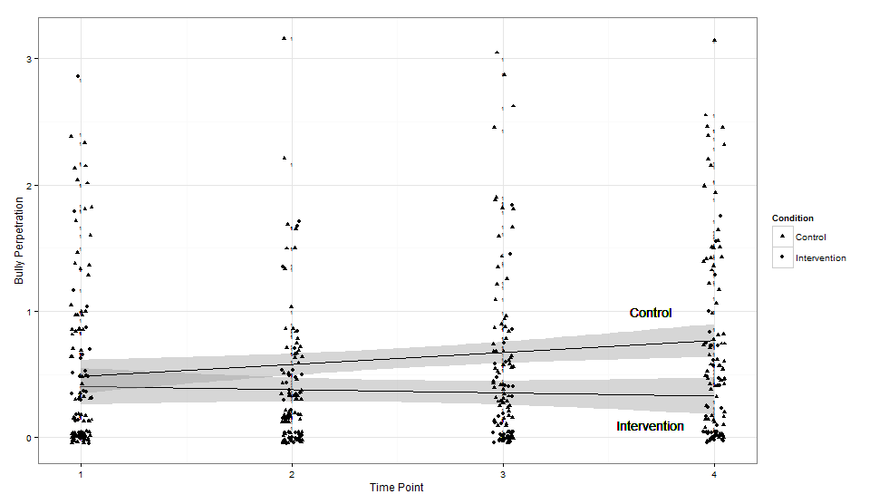
Students with Disabilities –
Bully Perpetration
(Espelage, Rose, & Polanin, 2015; 2016)

Slide 50
Results – High School Effects
Individuals in the treatment group reported significantly higher levels of growth in school belonging from T1 – T4 (b = .013, p = .042), growth in school belonging was in turn associated with reductions in growth in bullying perpetration from T5 – T7 (b = -.147, p = .067); Espelage et al., 2017.
+
Middle School – School Belonging
-
Second Step
Intervention
High School – Bully Perpetration

Slide 51
Teacher/Staff Perceptions of School Culture: Links to Student Reports of Bullying, Victimization, Aggression, & Willingness to Intervene
Dorothy L. Espelage, Ph.D.
Joshua Polanin, Ph.D.
Sabina Low, Ph.D.
School Psychology Quarterly (2014)
This research was supported by Centers for Disease Control & Prevention (#1U01/CE001677) to Dorothy Espelage (PI)

Slide 52
School Culture Matters
“school policies, attitudes and behaviors of teachers, administrators and the student body, and the overall atmosphere or school ethos, determine the internal life or social, emotional, and motivation climate of the school.” (Kasen et al., 2004).

Slide 53
School Environment Scale
Six scales emerged from factor analyses, measuring teacher/staff PERCEPTIONS OF:
  Student intervention (5 items; α = .83)
  Staff intervention (5 items; α = .89)
  Aggression being a problem (5 items; α = .80)
  School is doing professional development/administrator support (8 items; α = .90)
  Positive school climate overall (7 items; α = .85)
  Gender Equity/Intolerance of Sexual Harassment (7 items; α = .79)

Slide 54
Final Multi-level Model
Variable | Bullying Perpetration |  | Peer Victimization |  | Physical Aggression |  | Willingness to Intervene
 | β (SE) | B | β (SE) | B | β (SE) | B | β (SE) | B
Intercept | .39 (.03)** | - | .96 (.04)** | - | .96 (.05)** | - | 2.03 (.04)** | -
Individual
Female | -.03 (.02) | -.03 | -.05 (.03) | -.05 | -.20 (.03)** | -.21 | .14 (.02)** | .14
Mother’s Education | .01 (.01) | .01 | .01 (.03) | .03 | -.01 (.01) | -.03 | .02 (.01)** | .08
White | .17 (.02)** | -.15 | .11 (.05)* | .10 | -.51 (.05)** | -.47 | .18 (.03)** | .17
Hispanic | -.17 (.02)** | -.17 | -.23 (.05)** | -.23 | -.47 (.05)** | -.46 | .09 (.03)** | .09
Asian | -.22 (.04)** | -.07 | -.13 (.07) | -.04 | -.64 (.06)** | -.21 | .19 (.05)** | .06
Bi-racial | .11 (.03)** | -.08 | -.01 (.08) | -.01 | -.29 (.05)** | -.2 | .12 (.03)** | .08
School-level
Student Intervention | .15 (.14) | .04 | -.03 (.18) | -.01 | .19 (.20) | .05 | -.07 (.10) | -.02
Staff Intervention | .15 (.10) | .04 | .30 (.22) | .07 | .02 (.19) | .01 | -.02 (.11) | -.01
Aggression Problem | -.07 (.08) | -.04 | -.14 (.12) | -.08 | .09 (.12) | .05 | -.18 (.06)** | -.10
School Commitment to Bully Prevention | -.20 (.06)** | -.13 | -.42 (.09)** | -.27 | -.17 (.08)* | -.11 | .08 (.05) | .05
Positive Teacher-Staff-Student Interactions | -.01 (.11) | .01 | .14 (.16) | .04 | -.23 (.21) | -.07 | -.13 (.08) | .02
Gender equity/intolerance of sexual harassment | -.23 (.10)* | -.08 | -.71 (.20)** | -.24 | -.13 (.14) | -.05 | -.13 (.08) | -.05
State | .05 (.05) | .05 | -.04 (.03) | -.04 | .05 (.07) | .05 | .03 (.04) | .03
Free/Reduced Lunch | .01 (.01) | .05 | -.01 (.01)* | -.14 | .01 (.02)* | .26 | -.01 (.01)* | -.12
% Female | -.66 (.29)* | -.07 | -.71 (.32)* | -.08 | -.45 (.42) | -.05 | .17 (.25) | .02
% White | .17 (.11) | .06 | -.49 (.15)** | -.18 | .64 (.24)** | .23 | -.25 (.11)* | -.09

Slide 55
Final Multi-level Model
Variable | Bullying Perpetration |  | Peer Victimization |  | Physical Aggression |  | Willingness to Intervene
 | β (SE) | B | β (SE) | B | β (SE) | B | β (SE) | B
Intercept | .39 (.03)** | - | .96 (.04)** | - | .96 (.05)** | - | 2.03 (.04)** | -
Individual
Female | -.03 (.02) | -.03 | -.05 (.03) | -.05 | -.20 (.03)** | -.21 | .14 (.02)** | .14
Mother’s Education | .01 (.01) | .01 | .01 (.03) | .03 | -.01 (.01) | -.03 | .02 (.01)** | .08
White | .17 (.02)** | -.15 | .11 (.05)* | .10 | -.51 (.05)** | -.47 | .18 (.03)** | .17
Hispanic | -.17 (.02)** | -.17 | -.23 (.05)** | -.23 | -.47 (.05)** | -.46 | .09 (.03)** | .09
Asian | -.22 (.04)** | -.07 | -.13 (.07) | -.04 | -.64 (.06)** | -.21 | .19 (.05)** | .06
Bi-racial | .11 (.03)** | -.08 | -.01 (.08) | -.01 | -.29 (.05)** | -.2 | .12 (.03)** | .08
School-level
Student Intervention | .15 (.14) | .04 | -.03 (.18) | -.01 | .19 (.20) | .05 | -.07 (.10) | -.02
Staff Intervention | .15 (.10) | .04 | .30 (.22) | .07 | .02 (.19) | .01 | -.02 (.11) | -.01
Aggression Problem | -.07 (.08) | -.04 | -.14 (.12) | -.08 | .09 (.12) | .05 | -.18 (.06)** | -.10
School Commitment to Bully Prevention | -.20 (.06)** | -.13 | -.42 (.09)** | -.27 | -.17 (.08)* | -.11 | .08 (.05) | .05
Positive Teacher-Staff-Student Interactions | -.01 (.11) | .01 | .14 (.16) | .04 | -.23 (.21) | -.07 | -.13 (.08) | .02
Gender equity/intolerance of sexual harassment | -.23 (.10)* | -.08 | -.71 (.20)** | -.24 | -.13 (.14) | -.05 | -.13 (.08) | -.05
State | .05 (.05) | .05 | -.04 (.03) | -.04 | .05 (.07) | .05 | .03 (.04) | .03
Free/Reduced Lunch | .01 (.01) | .05 | -.01 (.01)* | -.14 | .01 (.02)* | .26 | -.01 (.01)* | -.12
% Female | -.66 (.29)* | -.07 | -.71 (.32)* | -.08 | -.45 (.42) | -.05 | .17 (.25) | .02
% White | .17 (.11) | .06 | -.49 (.15)** | -.18 | .64 (.24)** | .23 | -.25 (.11)* | -.09

Slide 56
Final Multi-level Model
Variable | Bullying Perpetration |  | Peer Victimization |  | Physical Aggression |  | Willingness to Intervene
 | β (SE) | B | β (SE) | B | β (SE) | B | β (SE) | B
Intercept | .39 (.03)** | - | .96 (.04)** | - | .96 (.05)** | - | 2.03 (.04)** | -
Individual
Female | -.03 (.02) | -.03 | -.05 (.03) | -.05 | -.20 (.03)** | -.21 | .14 (.02)** | .14
Mother’s Education | .01 (.01) | .01 | .01 (.03) | .03 | -.01 (.01) | -.03 | .02 (.01)** | .08
White | .17 (.02)** | -.15 | .11 (.05)* | .10 | -.51 (.05)** | -.47 | .18 (.03)** | .17
Hispanic | -.17 (.02)** | -.17 | -.23 (.05)** | -.23 | -.47 (.05)** | -.46 | .09 (.03)** | .09
Asian | -.22 (.04)** | -.07 | -.13 (.07) | -.04 | -.64 (.06)** | -.21 | .19 (.05)** | .06
Bi-racial | .11 (.03)** | -.08 | -.01 (.08) | -.01 | -.29 (.05)** | -.2 | .12 (.03)** | .08
School-level
Student Intervention | .15 (.14) | .04 | -.03 (.18) | -.01 | .19 (.20) | .05 | -.07 (.10) | -.02
Staff Intervention | .15 (.10) | .04 | .30 (.22) | .07 | .02 (.19) | .01 | -.02 (.11) | -.01
Aggression Problem | -.07 (.08) | -.04 | -.14 (.12) | -.08 | .09 (.12) | .05 | -.18 (.06)** | -.10
School Commitment to Bully Prevention | -.20 (.06)** | -.13 | -.42 (.09)** | -.27 | -.17 (.08)* | -.11 | .08 (.05) | .05
Positive Teacher-Staff-Student Interactions | -.01 (.11) | .01 | .14 (.16) | .04 | -.23 (.21) | -.07 | -.13 (.08) | .02
Gender equity/intolerance of sexual harassment | -.23 (.10)* | -.08 | -.71 (.20)** | -.24 | -.13 (.14) | -.05 | -.13 (.08) | -.05
State | .05 (.05) | .05 | -.04 (.03) | -.04 | .05 (.07) | .05 | .03 (.04) | .03
Free/Reduced Lunch | .01 (.01) | .05 | -.01 (.01)* | -.14 | .01 (.02)* | .26 | -.01 (.01)* | -.12
% Female | -.66 (.29)* | -.07 | -.71 (.32)* | -.08 | -.45 (.42) | -.05 | .17 (.25) | .02
% White | .17 (.11) | .06 | -.49 (.15)** | -.18 | .64 (.24)** | .23 | -.25 (.11)* | -.09

Slide 57
Final Multi-level Model
Variable | Bullying Perpetration |  | Peer Victimization |  | Physical Aggression |  | Willingness to Intervene
 | β (SE) | B | β (SE) | B | β (SE) | B | β (SE) | B
Intercept | .39 (.03)** | - | .96 (.04)** | - | .96 (.05)** | - | 2.03 (.04)** | -
Individual
Female | -.03 (.02) | -.03 | -.05 (.03) | -.05 | -.20 (.03)** | -.21 | .14 (.02)** | .14
Mother’s Education | .01 (.01) | .01 | .01 (.03) | .03 | -.01 (.01) | -.03 | .02 (.01)** | .08
White | .17 (.02)** | -.15 | .11 (.05)* | .10 | -.51 (.05)** | -.47 | .18 (.03)** | .17
Hispanic | -.17 (.02)** | -.17 | -.23 (.05)** | -.23 | -.47 (.05)** | -.46 | .09 (.03)** | .09
Asian | -.22 (.04)** | -.07 | -.13 (.07) | -.04 | -.64 (.06)** | -.21 | .19 (.05)** | .06
Bi-racial | .11 (.03)** | -.08 | -.01 (.08) | -.01 | -.29 (.05)** | -.2 | .12 (.03)** | .08
School-level
Student Intervention | .15 (.14) | .04 | -.03 (.18) | -.01 | .19 (.20) | .05 | -.07 (.10) | -.02
Staff Intervention | .15 (.10) | .04 | .30 (.22) | .07 | .02 (.19) | .01 | -.02 (.11) | -.01
Aggression Problem | -.07 (.08) | -.04 | -.14 (.12) | -.08 | .09 (.12) | .05 | -.18 (.06)** | -.10
School Commitment to Bully Prevention | -.20 (.06)** | -.13 | -.42 (.09)** | -.27 | -.17 (.08)* | -.11 | .08 (.05) | .05
Positive Teacher-Staff-Student Interactions | -.01 (.11) | .01 | .14 (.16) | .04 | -.23 (.21) | -.07 | -.13 (.08) | .02
Gender equity/intolerance of sexual harassment | -.23 (.10)* | -.08 | -.71 (.20)** | -.24 | -.13 (.14) | -.05 | -.13 (.08) | -.05
State | .05 (.05) | .05 | -.04 (.03) | -.04 | .05 (.07) | .05 | .03 (.04) | .03
Free/Reduced Lunch | .01 (.01) | .05 | -.01 (.01)* | -.14 | .01 (.02)* | .26 | -.01 (.01)* | -.12
% Female | -.66 (.29)* | -.07 | -.71 (.32)* | -.08 | -.45 (.42) | -.05 | .17 (.25) | .02
% White | .17 (.11) | .06 | -.49 (.15)** | -.18 | .64 (.24)** | .23 | -.25 (.11)* | -.09

Slide 58
Teacher/Staff perceptions of school culture:
Links To Student Reports Of Gender-based Bullying
Sarah Rinehart, M.A.
University of Illinois, Urbana-Champaign
Dorothy L. Espelage, Ph.D.
University of Florida
Psychology of Violence (2015)
This research was supported by Centers for Disease Control & Prevention (#1U01/CE001677) to Dorothy Espelage (PI)

Slide 59
Conclusions
Prevention programs yield reductions in bullying and victimization, and gender-based aggression; less so for TDV.
Effects are strongest among elementary school children & diminish has youth mature.
Perceptions of staff matter – intolerance for sexual harassment is critical to reduce gender-based bullying and other forms of aggression.
Peer norms matter - need to target these in programs
Finally, to narrow the research-practice gap, the research must be RIGOROUS & RELEVANT

Slide 60
Next Wave of Research
Gender-enhanced SEL Middle School Trial (Centers for Disease Control & Prevention)
Bullydown Text-Messaging SEL middle school program (Ybarra, Prescott, & Espelage, 2016).
SEL, Restorative Problem-Solving/Justice, & Student-Led Campaigns (National Institute of Justice)
Sources of Strength High School Suicide Prevention Evaluation for sexual violence outcomes (Centers for Disease Control & Prevention)
Bystander Bots (National Science Foundation)
Meta-analyses: (1) School violence (12K abstracts); (2) Cyberbullying interventions (National Institute of Justice)

