Slide 1
Associate Dean for Academic Affairs & Equity: Krista Chronister https://education.uoregon.edu/users/chronister
New Associate Dean position focused on improving…
  the diversity of our faculty who are involved with teaching and mentoring students; the curricula they teach; and the pedagogy that they use;
  the accessibility of our curricula and research opportunities to the full range of diverse learners; and
  equity in opportunities for students to learn and to share their knowledge and strengths

Slide 2
Student Resources – University Division on Equity and Inclusion
Multicultural Center
https://inclusion.uoregon.edu/node/68
Center for Multicultural Academic Excellence
Consultation, advising, professional development workshops, tutoring
https://inclusion.uoregon.edu/content/center-multicultural-academic-excellence-cmae

Slide 3
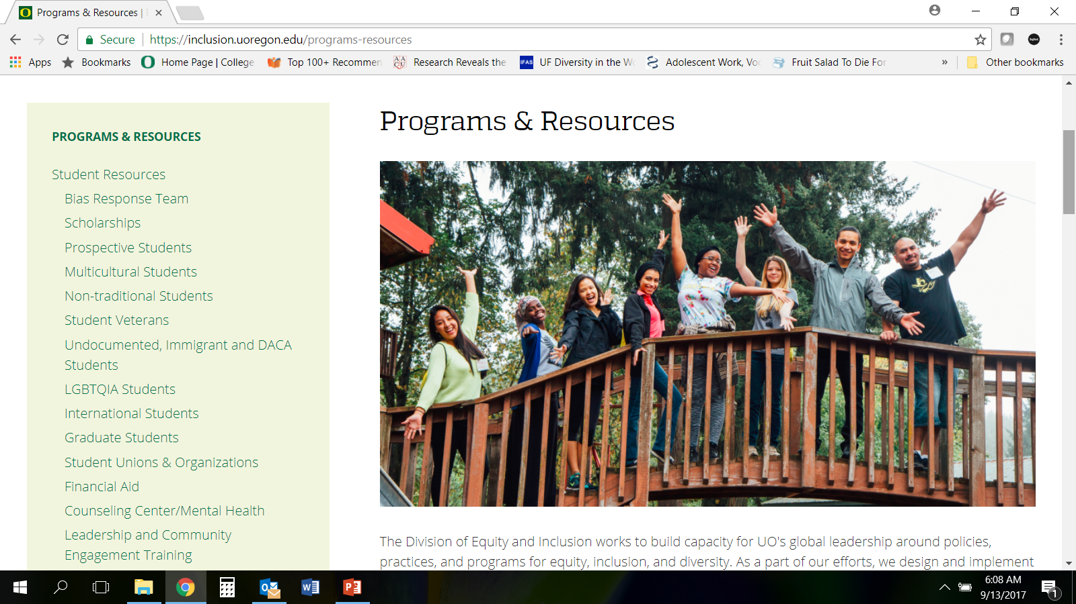
Student Resources – University List https://inclusion.uoregon.edu/programs-resources

Slide 4
Student Resources - University
Graduate School
Inclusive of Alliance of Graduate Students & GTFF (GE Union)
https://gradschool.uoregon.edu/
Consultation, professional development workshops, and emergency funds related to medical difficulties

Slide 5
Student Resources - University
Teaching Engagement Program
Instructional development workshops and certification and on-line resources for universal design, syllabus creation, etc.
http://tep.uoregon.edu/
Fall term workshops include:
Basic Teaching Skills (Leading a Discussion)
Teaching in the U.S. for International Graduate Students
Teaching for the First Time as the Sole Instructor
Teaching Large Classes

Slide 6
National Center for Faculty Development & Diversity (NCFDD)
https://www.facultydiversity.org/
FREE – UO pays for an institutional membership. Graduate students have complete access to this website and it is also designed for them!
On-demand mentoring, tools and support needed to be successful in the academy. Professional development workshops, mentors, resources, etc. focus on writing; getting mentoring; thriving in a predominantly White institution; etc.
Click on Become a Member tab at top
Click on Claim Your Institutional Membership
Complete registration information
You will receive email confirmation within a few days

Slide 7
Student Resources – College
Higher Education Leadership in Equity and Diversity (LEAD) Trainees
Graduate students in each Department working to connect students from underrepresented groups; to be available for individual and group consultation/connection; host community diversity events; and create a community of scholar-learners who are advancing College equity and inclusion goals.
One of three CPHS LEAD trainees is CPSY doctoral student Kayla Vargas at kmv@uoregon.edu. The other LEAD trainees are CFT students Hoda Tirafkan at hodat@uoregon.edu and Cella Oreta at Marcella@uoregon.edu

Slide 8
Student Resources - College
Student Diversity Affairs Committee
Hosts student conversation forums and social and academic events to support students from underrepresented groups and advance knowledge about diversity, equity and inclusion
Graduate student space – NEW!
270 Lokey College of Education
Coming soon fall term the Dean’s Office and LEAD Trainees will host a grand opening for a new graduate student lounge where students can study, eat, work, meet, and more…

Slide 9
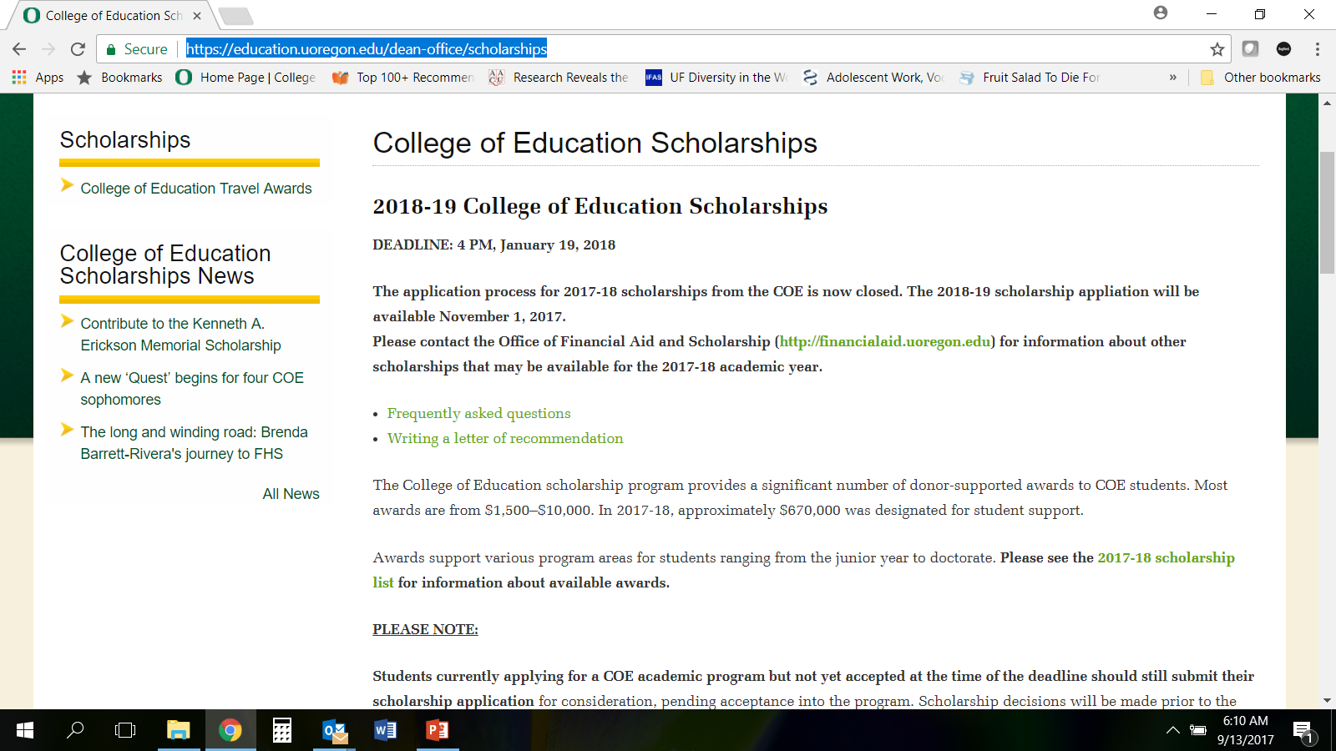
Student Funding – College https://education.uoregon.edu/dean-office/scholarships

Slide 10
Student Resources - College
Office of the Dean/ Associate Dean for Academic Affairs and Equity
Several administrative staff, including the Associate Dean for Academic Affairs and Equity, are available to meet with students to talk about positive experiences as well as support students with concerns and challenges that they might be experiencing within their programs

