Slide 1
Creating Figures Visualizing Data, Relationships, Theories, and More
Ross Anderson

Slide 2
Agenda
Introductions (20)
Purpose of figures (5)
Steps and tips (20)
Pitfalls and principles (5)
BREAK (10)
Critique & refine (45)
Resources & evaluation (15)

Slide 3
Ross Anderson
Program: 5th-year Ph.D. candidate in Educational Methodology, Policy, and Leadership
Work: Researcher at Educational Policy Improvement Center (EPIC)
Research interests:
Creativity in teaching and learning
Motivation and engagement
School change and organizational theory
Quantitative mostly with qualitative methods for developmental and mixed methods work

Slide 4
Assignment debrief
In pairs, share (5 min.)…
A challenge you faced in the task
Something that you learned from drafting your figure
Something that you learned from looking at your partners’ figure
Discuss as a group (10 min.)…

Slide 5
A great visualization example
A Timeline of Earths Average Temperature

Slide 6
Eight things figures can do for you
Theory of change, logic model, and data visualization galore
Provide a roadmap early and close the loop later
Express complex or abstract ideas with visual anchor/metaphor
Show relationships within complex systems
Meet the needs of different types of readers and learners
Provide concise way to share ideas in conceptual phase
Adds beauty—the persuasive power of aesthetics
Win grant awards
Notes:
Laura Lee McIntyre
Dave DeGarmo
Gina Biancarosa

Slide 7
Before you sharpen your pencil…
Use principle of information value and ask yourself…
Will the figure add substantively to paper?
Is figure best way to communicate information?
Can a figure capture essence without distracting reader?
Does the figure belong in primary or secondary documents?
(Steps and principles are drawn from APA publication manual 6th edition, Rougier, Droettboom, & Bourne, 2014, and my own experience)

Slide 8
Making a Great Figure
Graphs
display results for continuous or categorical variables
Charts
illustrate nonquantitative info such as logic, theories, or flow
Maps
describe spatial relationships
Drawings
illustrate information or data through pictures using metaphor
Photographs
represent information explicitly

Slide 9
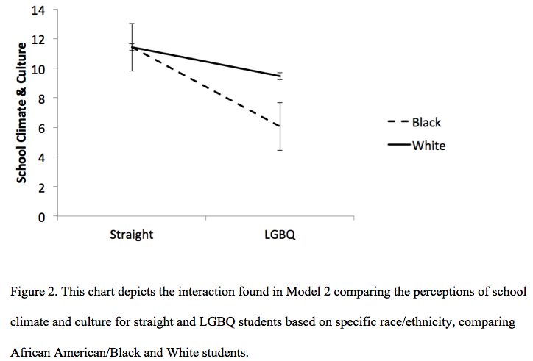
Graphs

Slide 10
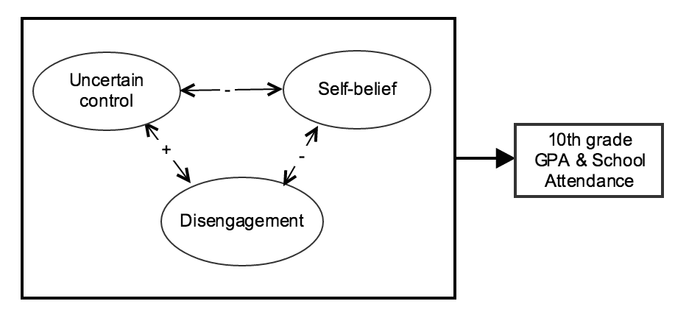
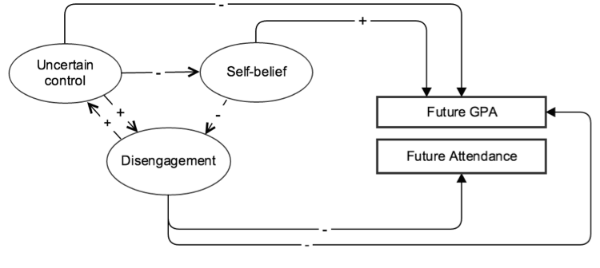
Charts Simple Path Models
Theoretical
Empirical

Slide 11
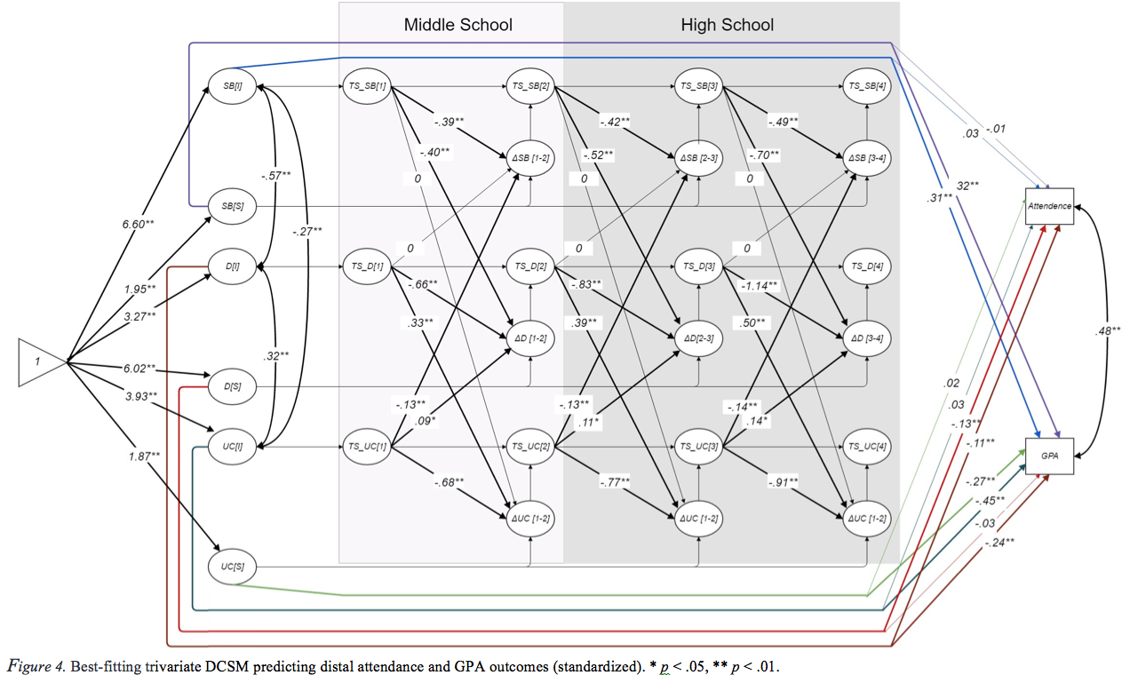
Complex Path Models
Notes:
Ask about any features and techniques used in this

Slide 12
Maps

Slide 13
Drawings

Slide 14
Photograph
Figure 1. In this photograph a student discusses their approach to observing well. ArtCore is student voice in learning.

Slide 15
A Quick Challenge
Work with a partner on the whiteboard or on paper and build a visual model of how figures can be useful in scholarly writing.
Theory of change, logic model, and data visualization galore
Provide a roadmap early and close the loop later
Express complex or abstract ideas with visual anchor/metaphor
Show relationships within complex systems
Meet the needs of different types of readers and learners
Provide concise way to share ideas in conceptual phase
Adds beauty—the persuasive power of aesthetics
Win grant awards

Slide 16
Step 1: Know the needs of your audience
Different Audiences:
Practitioners
Researchers
Policymakers
Parents and Public

Slide 17
Step 2: Know your message
What is the role of the figure?
What is the underlying message?
Is the message striking?
What are the design considerations?

Slide 18
Step 3: Affordances of the medium
Will you be presenting figure in an oral presentation?
Must be quickly understood and easily visible to audience
Will you be presenting figure on a poster?
Must be understood without much background
Will you be presenting figure in a publication?
Reader can spend as much time as they want and flip pages

Slide 19
Step 4: Defaults and color
Beware of program defaults
Colors can enhance elements or confuse reader
Consider effect of similar colors on colorblind readers
Printing is expensive, don’t overuse it

Slide 20
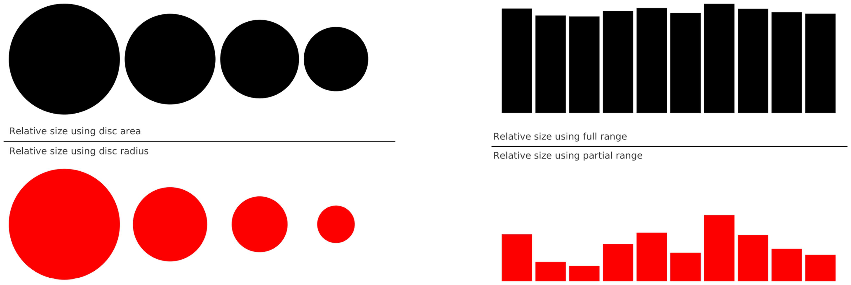
Step 5: Avoid misleading elements and chartjunk
When figures represent data, take care in rescaling
Rule of thumb: Use simplest plots and ask others to interpret
(from Rougier et al., 2014)
Notes:
Rule

Slide 21
Hey, not so fast…

Slide 22
Step 5: Avoid Chartjunk
“Above all else show the data.”
Edward Tufte (1983)
Includes unnecessary…
Color or backgrounds
Gridlines, labels, or arrows
Any details better fit for a results table or explanatory narrative
For more on Chartjunk, visit Kaiser Fung’s blog www.junkcharts.typepad.com

Slide 23
Step 6: Obsess over message not beauty
Less is more—a philosophy of minimalism
We dwell in words and numbers, but we live by beauty…
But precision and meaning (usually) trump aesthetics
If you have stumbled upon a unique data or concept visualization challenge, chances are someone else has, too
Notes:
In art, we seek multiple interpretations, in science we strive to eliminate alternative interpretations

Slide 24
Step 7: Captions and labels
Caption serves as title and description of figure
Should communicate everything the reader needs to know
Complete sentences are a good idea.
Like a “Note” in a table, caption should explain labels in figure:
Unit of measurement
Symbols
Abbreviations
Standard errors, standard deviations, or confidence intervals
Sample size
Meaning of statistical significance values
Ensure agreement between caption, figure, and rest of paper

Slide 25
Common Pitfalls
Too much text
Too many arrows
Unclear flow to movement in graphic
Making reader return to narrative to understand figure (i.e., underspecified caption)

Slide 26
Review of Principles
Don’t duplicate what’s in the text
Know audience
Go for precision and readability
Message and purpose is clear
Don’t distract viewer
Descriptive figure caption
Labeled units of measure, internal features, and sharp lines
Consistent style across article or presentation

Slide 27
In case that wasn’t enough…
Some extras from APA:
For graphs, legends should use same kind and proportion of lettering that appear in graph and be found inside figure
Parallel figures should be of equal size (e.g., multiple graphs)
Avoid too many different shadings in one document
Simple, spacious typeface (Arial, Future, or Helvetica)

Slide 28
Break
Meet back in 10 minutes

Slide 29
Critique & refine
One example together (10)
Refer to handout and exchange feedback on your own (5)
Choose 1-2 from the handout and critique at your table (10)
Full group discussion (5)
Design challenge (10)

Slide 30
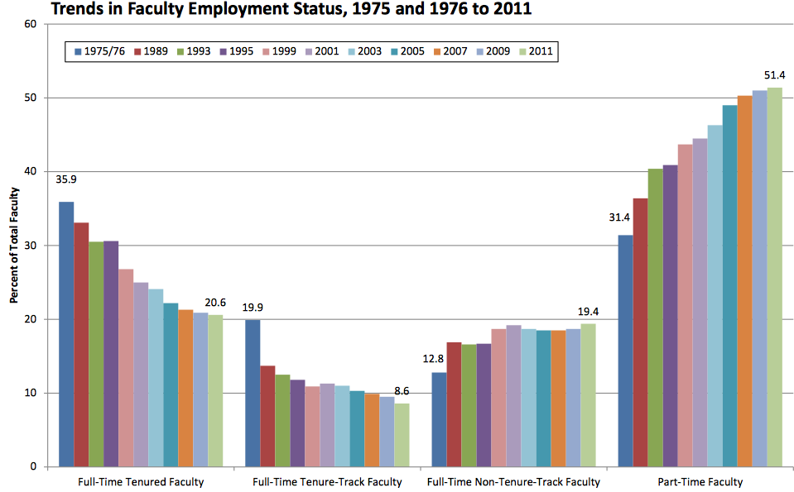
From (Sutton, 2014) http://www.databoxdigital.com/2014/05/01/choosing-graph-types/
Notes:
Time series doesn’t show difference in time intervals. Too many colors to try to keep track of. Colorblindness

Slide 31
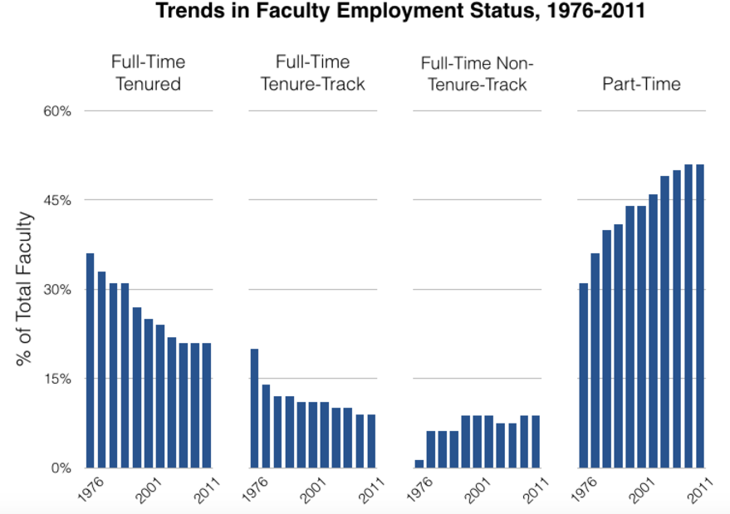
Notes:
Lose the specificity of time series. What are the gaps years. You lose the value of the first and last years

Slide 32
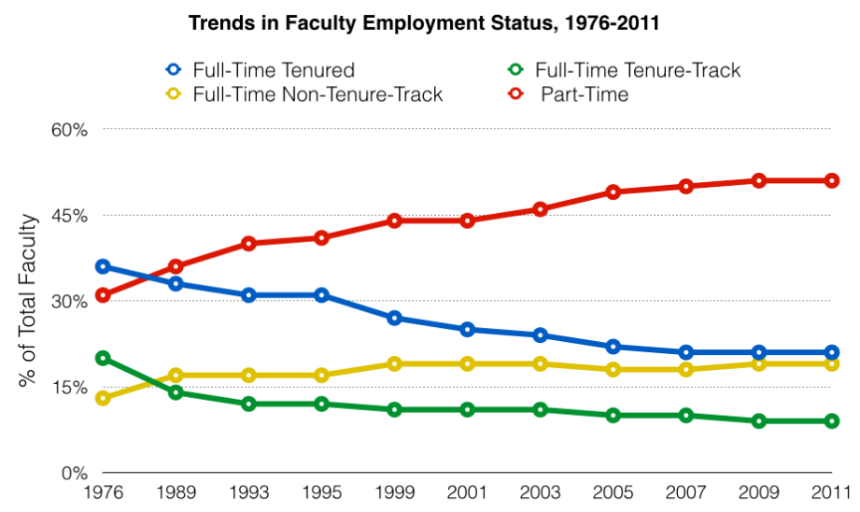
Notes:
Shows trends nicely with fidelity to accuracy and identifies years where there are intersections

Slide 33
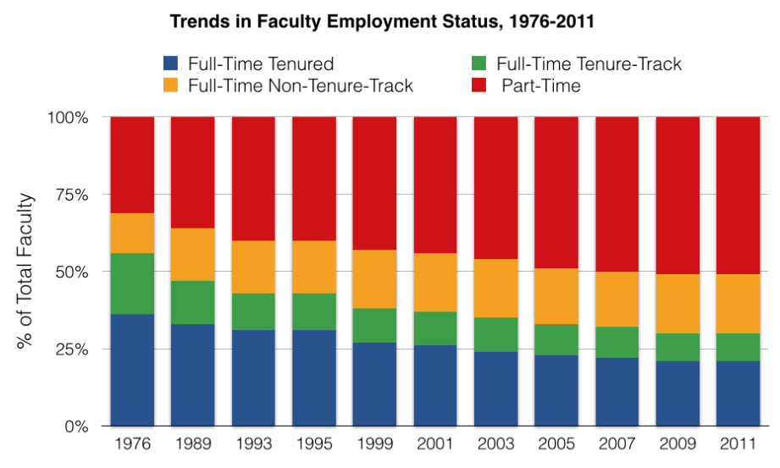
Notes:
Do you like the line graph better for some reason?
You still can’t tell what these trends mean in the overall trend of the market. Is it declining or increasing?
What is the message you want to convey?

Slide 34
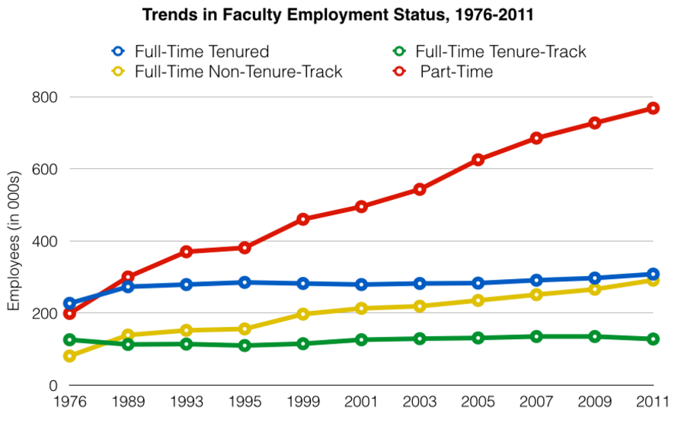
Notes:
Clearly market is growing, its just mostly part-time faculty. Is something missing? Still don’t have overall market size explicit and the overlapping at the beginning makes it harder to read

Slide 35
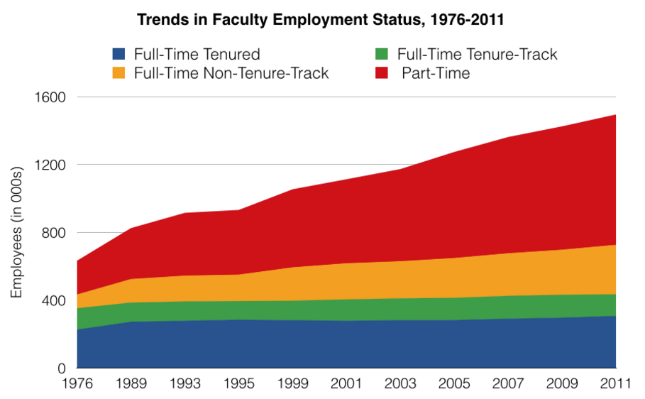
Notes:
Stacked – gives overall market size, individual job type size and implied distribution across types
But there is one more problem that may mislead readers…if they haven’t gotten it already

Slide 36
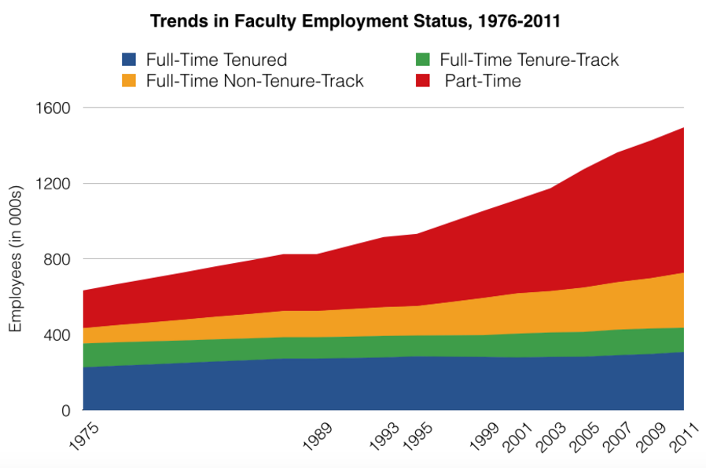
Notes:
What is the new meaning that you can pull out from this? What is different

Slide 37
Chronosystem
Macrosystem
Exosystem
Mesosystem
Mesosystem
Microsystem
Microsystem
Microsystem
Notes:
What would be the best venue for use of this one?
What message is conveyed strongest?

Slide 38
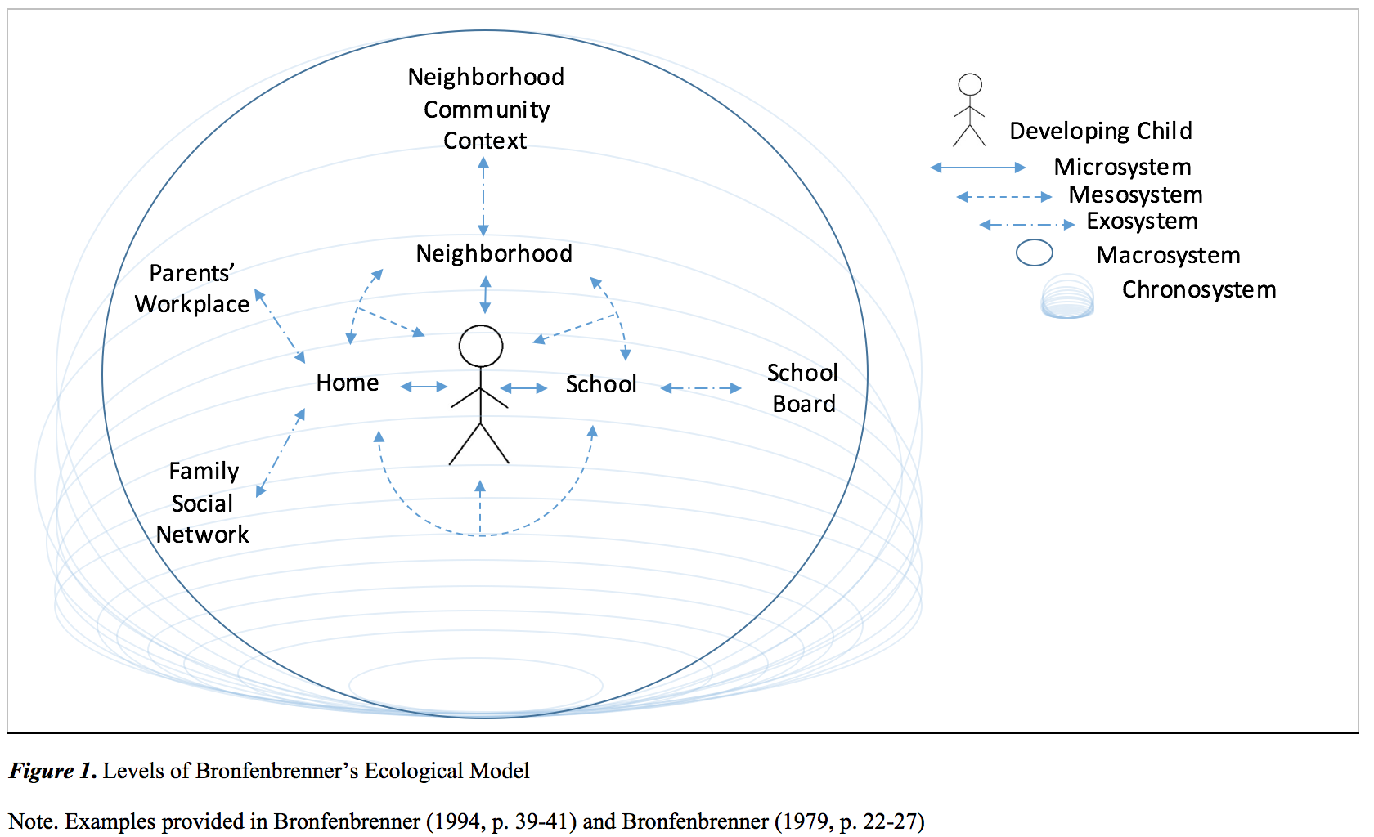
Notes:
What message is conveyed strongest?

Slide 39
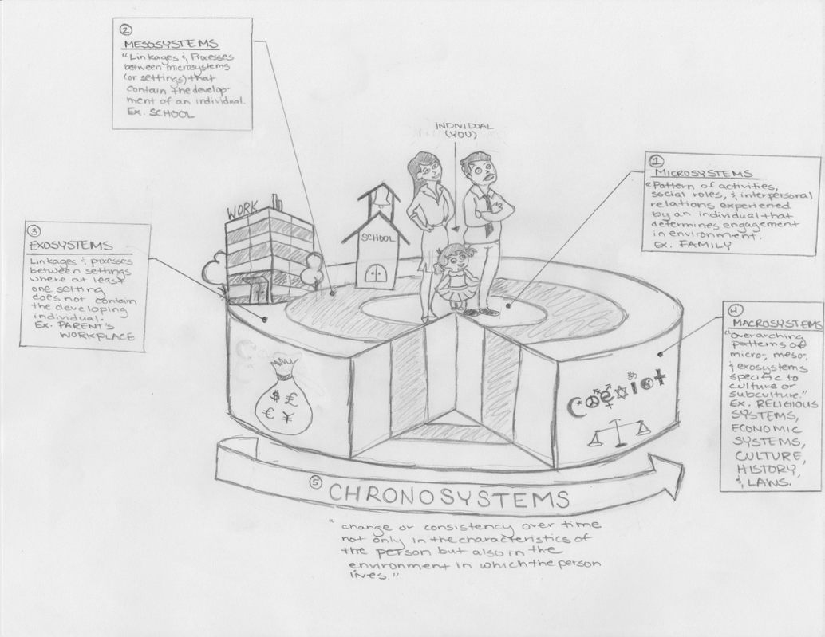
Figure 1. Draft of Bronfenbrenner’s (1994) Ecological Model of Human Development.
Notes:
What message is conveyed strongest?

Slide 40
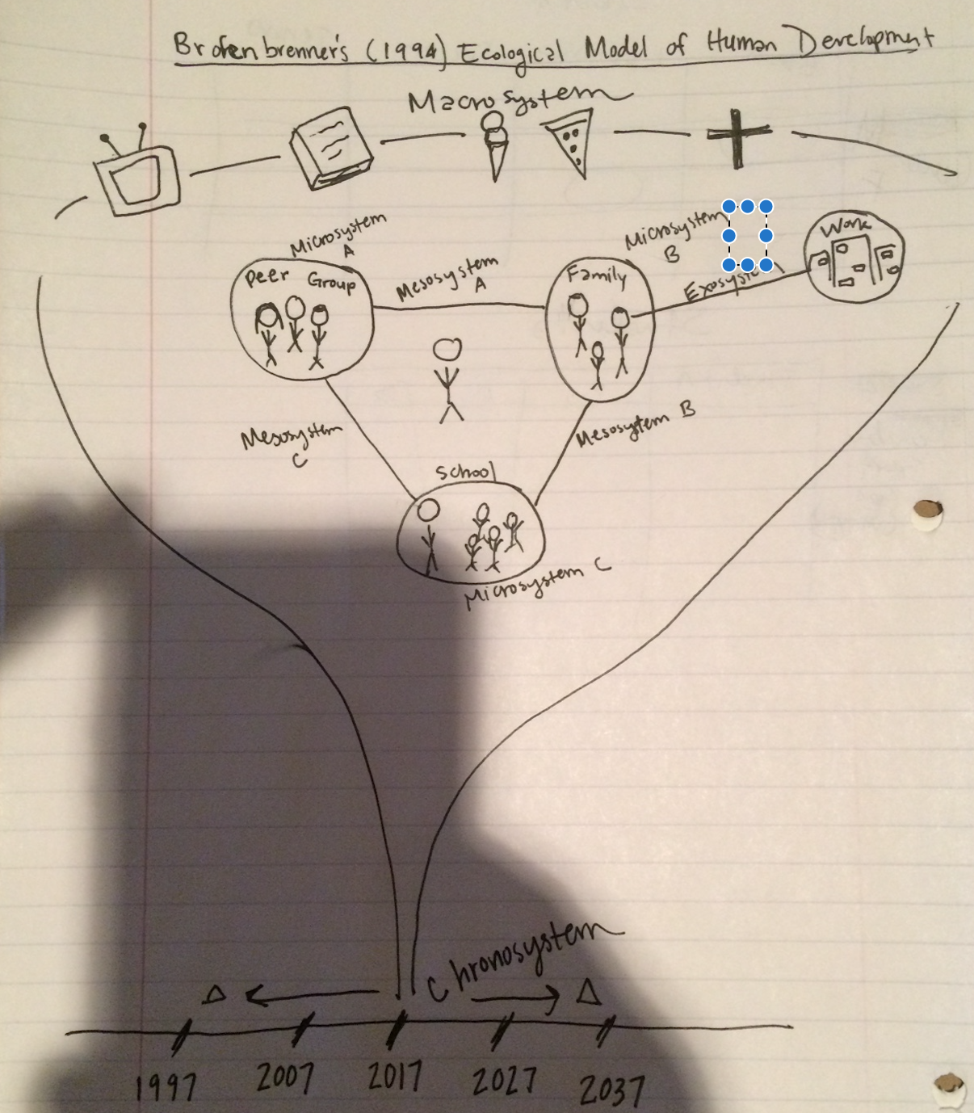
Notes:
What is the message conveyed clearly here?

Slide 41
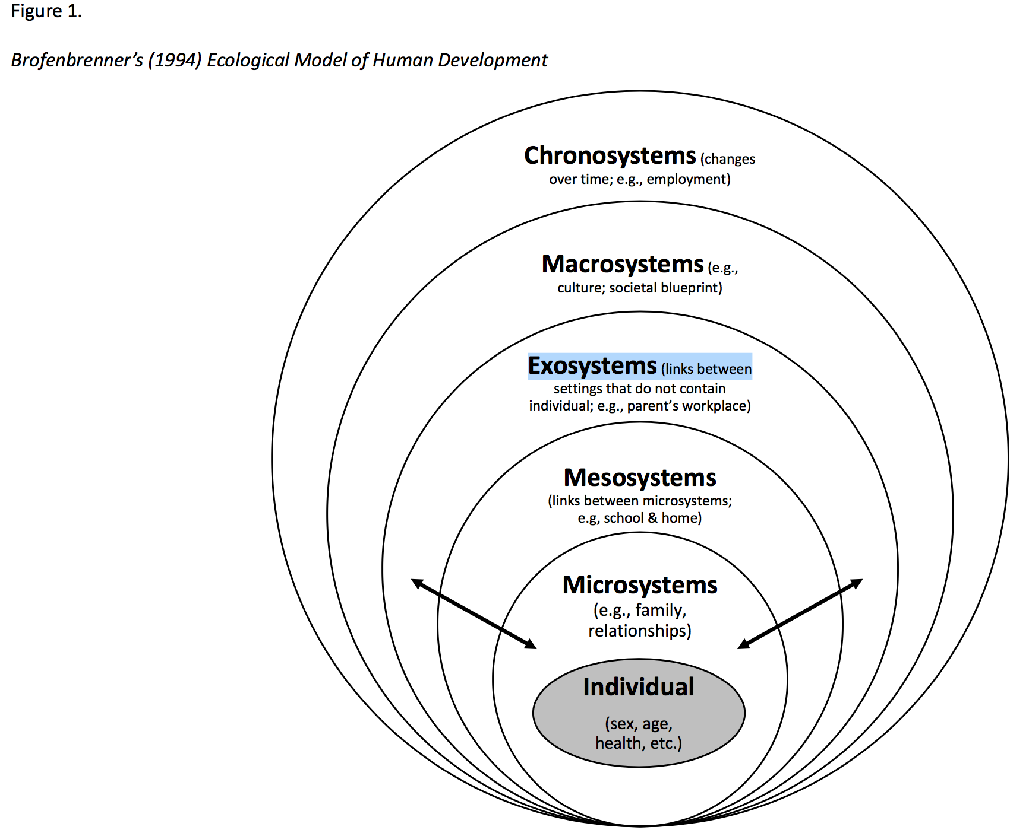
Notes:
What message is conveyed strongest?

Slide 42
A impassioned plea
Drawing figures can be a product that communicates your good thinking to others but, more importantly, it can be a process that advances your thinking to the next level.
Remember: No one ever put a limit on how rough a draft can be.

Slide 43
Programs
To start…
Pencil sketches are terrific!
Mess around in powerpoint if that is most comfortable
Try out Gliffy for free: https://www.gliffy.com/
Take an online tutorial for excel (beware of defaults)
Try out one of the packages suggested by Rougier et al. (2014)
https://inkscape.org/en/#features

Slide 44
References
American Psychological Association (2010). Publication manual of the American Psychological Association 6th edition. Washington, DC: American Psychological Association.
Rouier, N.P., Droettboom, M., & Bourne, P.E. (2014). Ten simple rules for better figures. PLoS Computational Biology, 10(9), pp. 1-7. Retrieved from http://journals.plos.org/ploscompbiol/article?id=10.1371/journal.pcbi.1003833
Sutton, C. (May, 2014). Choosing your graph types. Retrieved from http://www.databoxdigital.com/2014/05/01/choosing-graph-types/

Slide 45
Thank You
Ross Anderson
rossa@uoregon.edu
(541) 214-0949
www.artcorelearning.org
@UpEduvate

