Slide 1
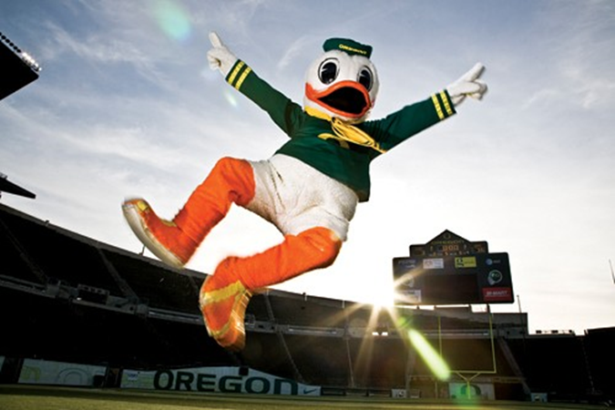
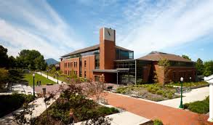
WELCOME!
University of Oregon
Prevention Science Programs
Orientation
September 16,2016

Slide 2
2016 Cohort
Introductions
Who are you?
Where is home for you?
What attracted you to this university & program? What do you hope to gain?
Something you’d like us to know about you?

Slide 3
A new year with new beginnings….
New programs and PREV major approved last year
Doctoral, MS, and M.Ed.
New coursework and faculty

Slide 4
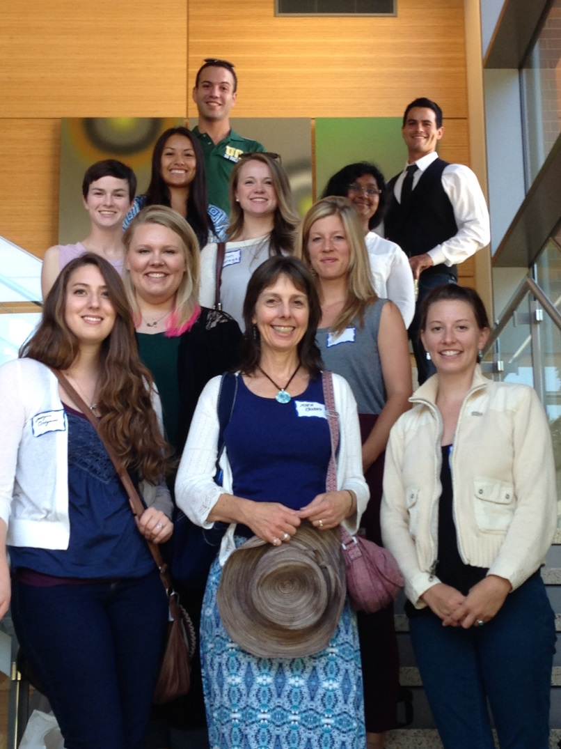
UO Prevention Science (2013 to 2016)

Slide 5
Prevention Science Program Faculty
Program Directors
Elizabeth Stormshak, Professor (Masters)
Leslie Leve, Professor (Doctoral)
Core Faculty
Krista Chronister, Associate Professor
Jessica Cronce, Assistant Professor
Ellen Hawley McWhirter, Professor, CPSY Training Director
Atika Khurana, Assistant Professor
Deanna Linville, Associate Professor, CFT Training Director
Benedict McWhirter, Professor, CPHS Department Head
Elizabeth Skowron, Professor, CPHS
Jeff Todahl, Associate Professor
John Seeley, Professor, SPECS
Nichole Kelly, Assistant Professor, CPHS
Tasia Smith, Assistant Professor, CPHS
Liz Budd, Assistant Professor, CPHS
Nicole Giuliani, Assistant Professor, SPSY

Slide 6
Program Community
Student Service Coordinator:
Becca Marx

Slide 7
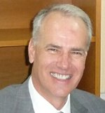
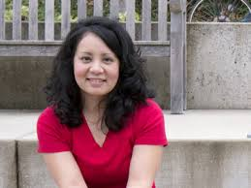
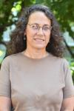
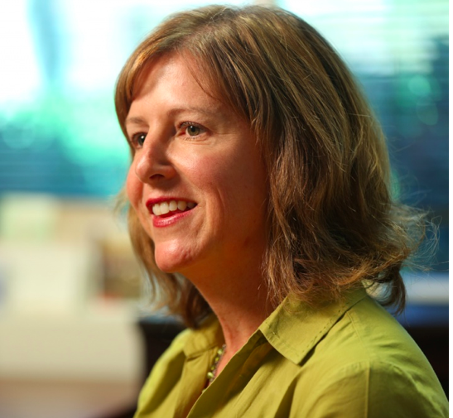
College of Education (COE) Administration
Randy Kamphaus, PhD,
Dean
Krista Chronister, PhD,
Assistant Dean for Equity & Inclusion
Brigid Flannery, PhD,
Associate Dean for Academic Affairs
Leslie Leve, PhD, Associate Dean for Research & Faculty Development

Slide 8
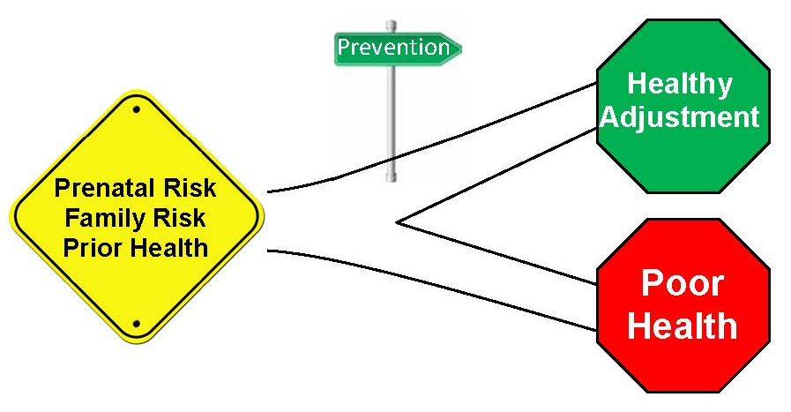
What is Prevention?
“The act of stopping something from
happening or arising.”
“Activities that promote positive action or behavior.”

Slide 9
What is Prevention Science?
Prevention science is a multidisciplinary field, integrating theories and methodologies from the disciplines of public health, human development, education, behavioral science (e.g., psychology, sociology, and developmental neuroscience), economics, evaluation, epidemiology, and public policy and administration.
Prevention Science graduate programs emphasize research training in a strengths-based approach that aids in “identifying malleable risk and protective factors, assessing the efficacy and effectiveness of preventive interventions, and identifying optimal means of dissemination and diffusion” (Society for Prevention Research, 2011).

Slide 10
History of prevention science at UO
Longstanding history that goes back decades
Eugene has always been known as a center for prevention science research
Strong community collaborators, Oregon Research Institute (ORI), Oregon Social Learning Center (OSLC)
Multi-disciplinary focus at UO across colleges, COE, psychology

Slide 11
Prevention Science Institute
MISSION
The Prevention Science Institute (PSI) at the University of Oregon is a multi-disciplinary institute focused on understanding human development, preventing behavioral health problems, and implementing effective interventions in community settings. Our core mission is to improve the lives and well being of at-risk children, individuals, and families throughout the lifespan.
http://psi.uoregon.edu

Slide 12
Areas of Focus at PSI
Translational Neuroscience
fMRI, EEG lab, RSA, cortisol, genetics
Prevention and Intervention
Efficacy trials and development of effective interventions
Implementation Science
Dissemination of interventions to community settings

Slide 13
Examples of our research
Understanding the impact of prevention on self-regulation and inhibitory control using fMRI techniques
Testing the efficacy of a family-centered interventions for families to prevent problem behavior in children with developmental delays
Understanding effective dissemination of evidenced based practices in real world settings
Isolating the effects of environment vs. genes in children in the development of obesity, psychiatric disorders, and health
Testing the efficacy of a parenting intervention for young children who have experienced child abuse, including the biobehavioral pathways to positive parenting
Developing and testing a web-based intervention for schools to prevention problem behavior

Slide 14
Program Goals and Competencies
Goal #1: To produce graduates who can describe theoretical models, risk and protective factors, preventive interventions (especially evidence-based interventions), and implementation practices related to prevention science programs and policies for diverse populations;
Goal #2: To produce graduates who understand and adhere to the standards of knowledge for prevention science, including best practices in research design and methods, data analysis, interpretation, dissemination, self-evaluation, and rigorous ethical practice;
Goal #3: To produce graduates who are committed to multicultural competence and enhancing human welfare in their scholarly work related to prevention science;
Goal #4: To produce graduates who display professionalism in their relationships with faculty, staff, peers, and community partners in diverse settings;
Goal #5: To produce graduates who demonstrate in-depth knowledge in a specialization area of prevention science (e.g., advanced methodology, school-based health, applied developmental neurobiology).

Slide 15
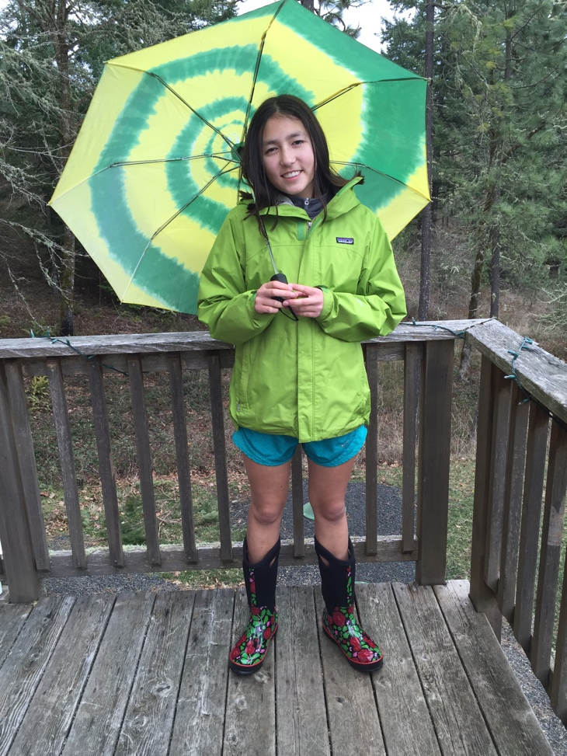
Prevention Science Graduate Programs
Handbook
Courses & Registration
Course Progression (MEd, MS, PhD)
Advising (academic vs. research)
Research requirements
Capstone
MS project
Dissertation

Slide 16
Capstone Projects (M.Ed.)
Integrative, year-long research project (qualitative or quantitative)
Design and conduct a specific research study that draws from existing prevention science-oriented data sets at the UO
Give an oral presentation (audiovisual) to summarize your research study and findings to program faculty and students
Prepare a written report on your project’s focus and findings, process analysis of the research experience, all grounded in SPR guidelines for prevention science.
Prevention Science Research Seminar
Fall, Winter, Spring terms
Regular faculty & peer consultation and support social enterprise

Slide 17
Example UO Capstone Projects
Adolescent Parenthood and Associated Risk of Adult Involvement with Child Welfare
Barriers to Implementation of Evidence Based Practices: Responses from the Field
Multidimensional Treatment Foster Care in juvenile justice system: Outcomes for females with sexual abuse history
What AlcoholEdu Tells Us about Freshman Marijuana Use at the University of Oregon

Slide 18
Masters of Science Research Project
Students write a final paper to complete the MS degree
Students work with their advisor to identify the paper topic and plan for the project
Publishable quality paper that can be submitted to a journal
Paper should be completed and approved by the first week of the quarter of anticipated graduation
MS students will use the capstone process (in the prev seminar) to begin planning for this paper

Slide 19
Doctoral student research requirements
“Pre-dissertation” research paper
Comprehensive exam
Teaching competency
Dissertation

Slide 20
Prevention Science Externships (i.e., PREV 605 Field Studies)
Lane County Prevention
PAX-Good Behavior Game Implementation
Contact Emily Bear Emily.BEAR@co.lane.or.us
UO SNAP lab
FIND (Filming Interaction to Nurture Development) Study
Contact Melanie Berry MelanieB@oslc.org
UO Office for Student Life
Prevention programming implementation & evaluation
Contact Robin Holmes roses@uoregon.edu

Slide 21
State of Oregon: Certified Prevention Specialist (CPS)

Slide 22
What classes do take this quarter? And this year? (Masters)
FALL | WINTER | SPRING
PREV 631:Intro to Prevention Science | EDUC 614 Educ Statistics | EDUC 640: Appl Stat Design and Analyses
CPSY 621: Lifespan Development | CPSY 645: Health Promotion and Equity | PREV 633 Contem issues in public health
EDUC 612 Social Sci Research Design | Elective | Elective
*SPSY 610 Neuroscience for Educators | Elective | Elective
PREV 607: Prev Sci Sem | PREV 607: Prev Sci Sem | Prev 607: Prev Sci Sem

Slide 23
Possible Electives offered in the COE and across campus
CFT 620: MH & Diagnoses (3)
SPSY 610: Social Aspects of Behavior (Var: 4-5)
CPSY 614: Theories of Counseling (3)
CPSY 617: Theories of Career Development (3)
CPSY 626: Psycholog Services Latinos (2)
EDLD 610 Culturally-adapted interventions (4)
PREV 605: Prev Sci Externship (1-4)
PREV 634: Implementation Science (3)
SAPP 507: AOD Pharmacology (3)
SAPP 507: AOD Prevention (3)
SPED 626: Grant Writing (3)
SPSY 610: Neuroscience for Educators (3)
SPSY 652: Biological Aspects of Behavior (4)

Slide 24
Electives offered this fall
EDUC 630: Qualitative Data I
EDUC 654 Applied Behavior Analysis
EDLD 610 Soc and Cult Foundations Educ
CPSY 613 Intro Counseling Psych
All look at PSYCH, SOCIOLOGY, ANTHRO, HUMAN PHYS, ETHNIC STUDIES, JOURNALISM

Slide 25
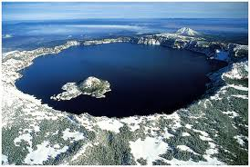
Program Norms
Read your program handbook, cover to cover
Attend classes – interactive experiences matter
Check email daily
Do not check email, text message, or take phone calls during class
Use prev-seminar time for advising needs

Slide 26
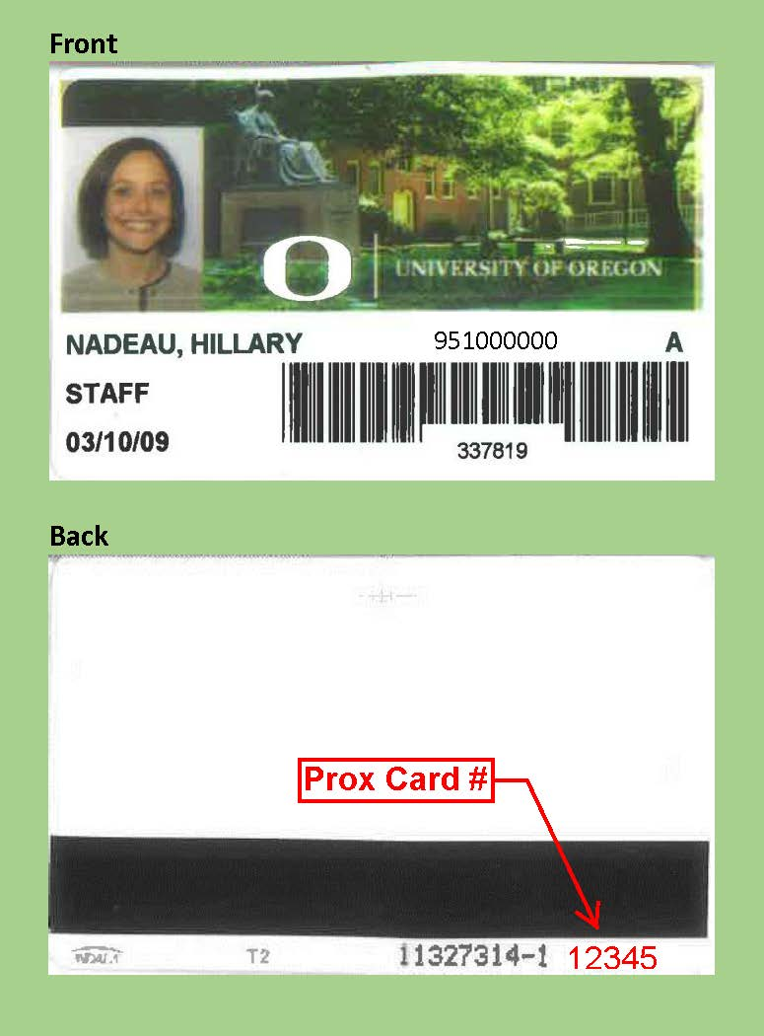
Program Nuts and Bolts
Deliverables
FERPA
Background check--results
Register for courses
Complete Program Plan
(Spring term)
Student ID & Prox #s

Slide 27
Program Nuts and Bolts
DuckWeb
Registration
Update address & contact info
UO Alert & Campus safety
Book store
Other options (Amazon, Smith Family, UO reserves)
Canvas: (undergraduate)
Obaverse (graduate)

Slide 28
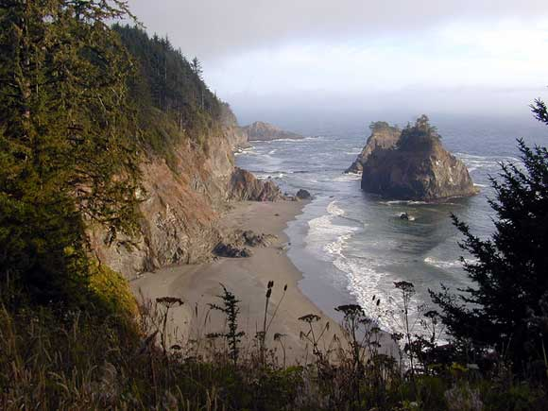
Nuts and Bolts
UO Website
Calendars
Class schedule
PrevSci Website
Student funding
Forms & Calendar
Email: check daily
prevsci@uoregon.edu
PrevSci Listserve
From Instructors

Slide 29
Nuts and Bolts
HEDCO Suite 240
Meeting rooms
Study alcove
Kitchen
Grad office 265 w/ Mailboxes
Learning Commons (HEDCO 110)
Computers (Mac/PC with SPSS)
Printing
HEDCO Café (aka Education Station)
Notes:
We do not have a cleaning service and it is a shared space. Please clean up after themselves. The mailboxes are all set up.

Slide 30
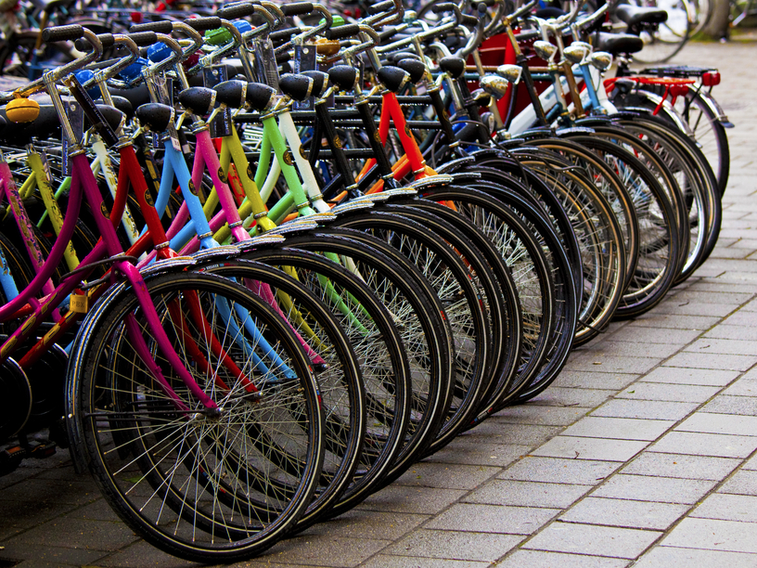
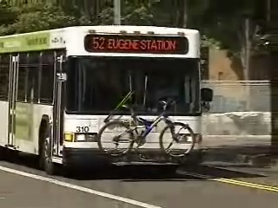
Transportation
Campus maps (on UO website)
Parking & permits
(Department of Parking & Transportation website)
Bicycles
Use UO ID for bus
Notes:
Bicycles are common on this campus but always lock your bike as they are often stolen. There are bike cages that you can pay for through the Parking & Transportation website) and there is one on the North side of Hedco.
With UO ID, can ride local buses for free. If the bus driver checks and no UO ID on them, they may get charged.

Slide 31
Resources
Recreation Center (paid for by student fees)
Eugene Weekly (free)
Accessible Education Center
COE Tutoring Services
HEDCO 130
Campus and student groups

Slide 32
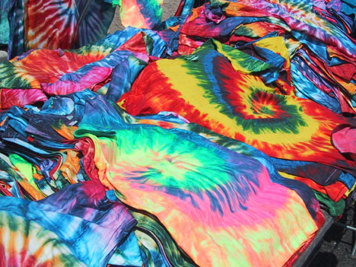
QUESTIONS??

