Slide 1

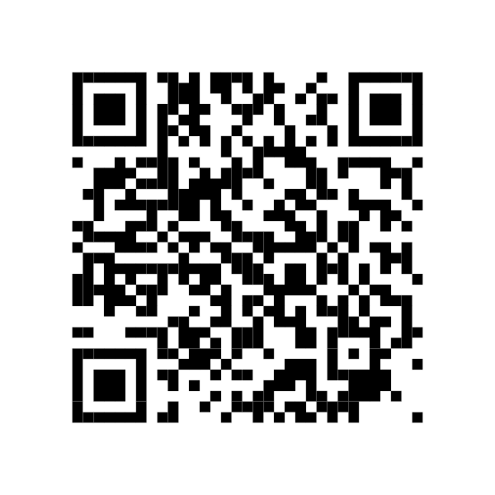
Participate in the Graduate Research Forum
Friday, May 10
Showcase your research, connect with your peers, and practice for conferences.
Participate with a poster or panel presentation.
Top posters and all selected panelists receive cash awards.
Submit Your Proposal by April 17 →

