Slide 1
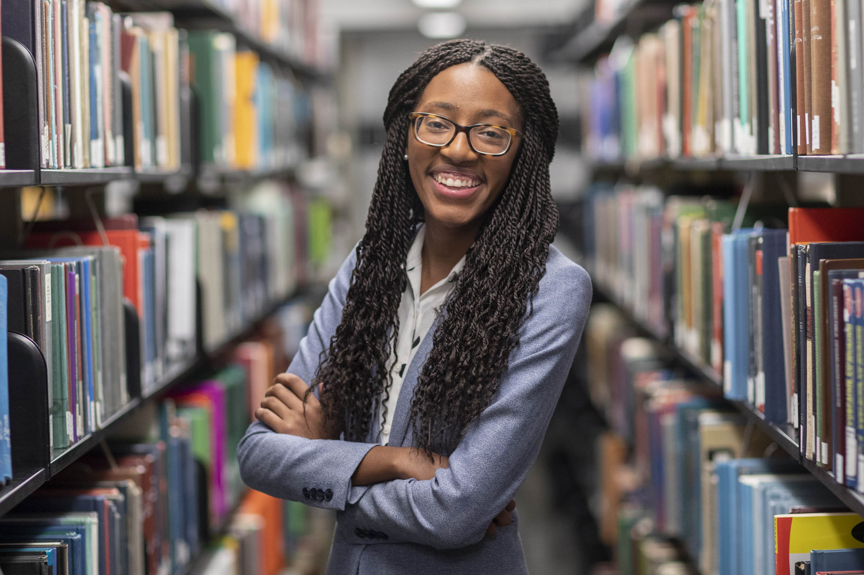
presents the
The 2022 Leona Tyler Memorial Visiting Professor in Psychology
Lauren Mims, PhD.
Ball State University
We are the Dreamkeepers: Applying the BlackCreate Framework to Support Brilliant Black Girls
The award-winning author Jacqueline Woodson asked herself “What am I going to do about a time of my life in which the brilliance of Black girls had no mirror?” as she wrote Another Brooklyn, a story about Black girlhood. This question is also relevant for the field: What are we going to do about a time in which the brilliance of Black girls has no mirror in research, policy, and practice? Dr. Mims will present her recent research focused on Black brilliance and creative problem solving in fugitive spaces. She will discuss her research on how African American youth actively construct their identities within socio-cultural contexts, the magic of homespaces in the Black community, and the feasibility and acceptability of a new Black history home learning program. In addition, Dr. Mims will present her vision for how we can all be dreamkeepers (Ladson-Billings, 1994).
Friday May 20th, 2022 • 3:30-5:00pm
Location – Straub Hall, Room 145
An equal-opportunity, affirmative-action institution committed to cultural diversity and compliance with the Americans with Disabilities Act.
This publication will be made available in accessible formats upon request.

