Slide 1
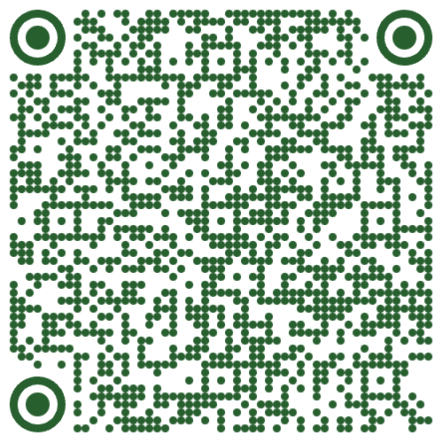
Join us for the 2024
University of Oregon Educator Career Fair

Slide 2
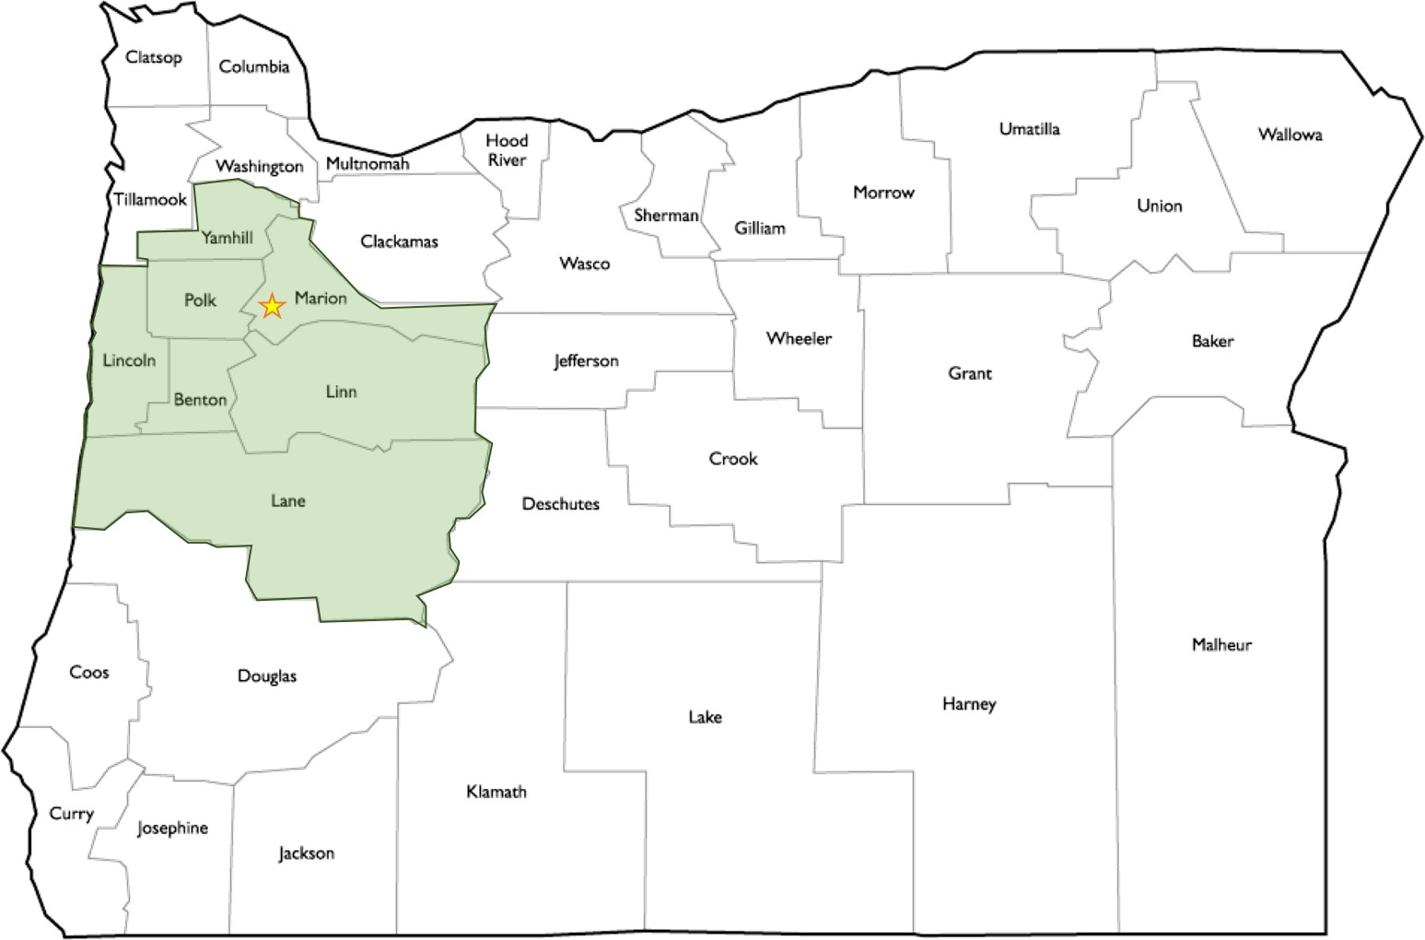
Districts Attending the UO Educator Career Fair on March 14
Oregon School Districts & ESDs
Beaverton SD
Bend-La Pine Schools
Bethel SD
Blachly SD
Central SD
Corvallis SD
Crook County SD
Eugene SD
Fern Ridge SD
Grants Pass SD
Greater Albany PS
Gresham-Barlow SD
Hillsboro SD
Jefferson County SD
Lane ESD
Medford SD
Redmond SD
Roseburg PS
Salem-Keizer PS
South Lane SD
Springfield PS
Sweet Home SD
UO’s Early Childhood CARES
Out-of-State
Boulder Valley SD, CO
Liberty Union High SD, CA Mystic Valley Regional Charter School, MA

Slide 3
Register via Handshake
This Career Fair is open to all UO students and alumni interested in pursuing careers in education. Our goal is to support you as you transition into or are looking for new opportunities in the educator workforce. You will meet with hiring representatives, practice marketing yourself, and hopefully get some valuable interviews!
2024 Educator Career Fair
When: March 14 (Thurs) 2:00 - 5:00 pm
Where: UO Ford Alumni Center ballroom (directions link)
Who: Interested undergrads, grads, & alumni
Student Registration Instructions:
Login to Handshake (https://uoregon.joinhandshake.com) with your UO Student ID#
Search “Events” for the “UO Educator Career Fair 2024,” there you will need to “+Join Event”
As you register, be sure to create and publish your Handshake portfolio; this allows districts to review your “resume” before and after the fair.

Slide 4
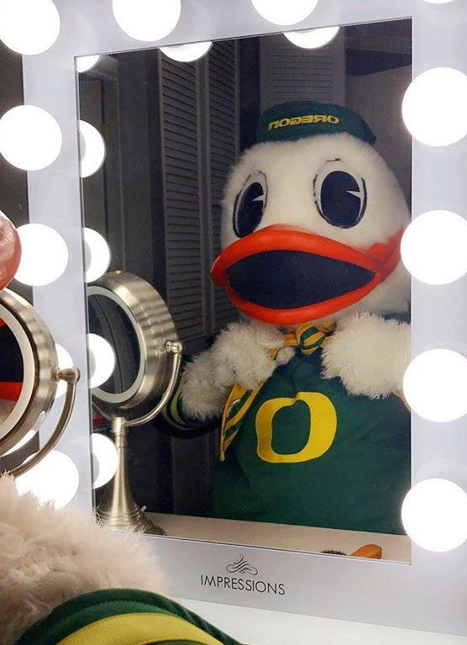
Prepare to Shine!
Prior Preparation:
Register on Handshake
Update your resume and publish it in your Handshake account
Review the event schedule
Use Handshake to research participating districts profiles
What to Bring:
30+ copies of your printed Résumé & 60 second Introduction Summarize background, skills, and aspirations: E.g. Hello, my name is_______. I am a student in the “_____“ program. This term I am doing a field study at ”_________.” I am interested in what type of __________jobs your district offers ….”)
Good Questions, e.g.
What types of jobs do you have for students or recent college graduates?
How do you create a sense of belonging among staff and students?

Slide 5
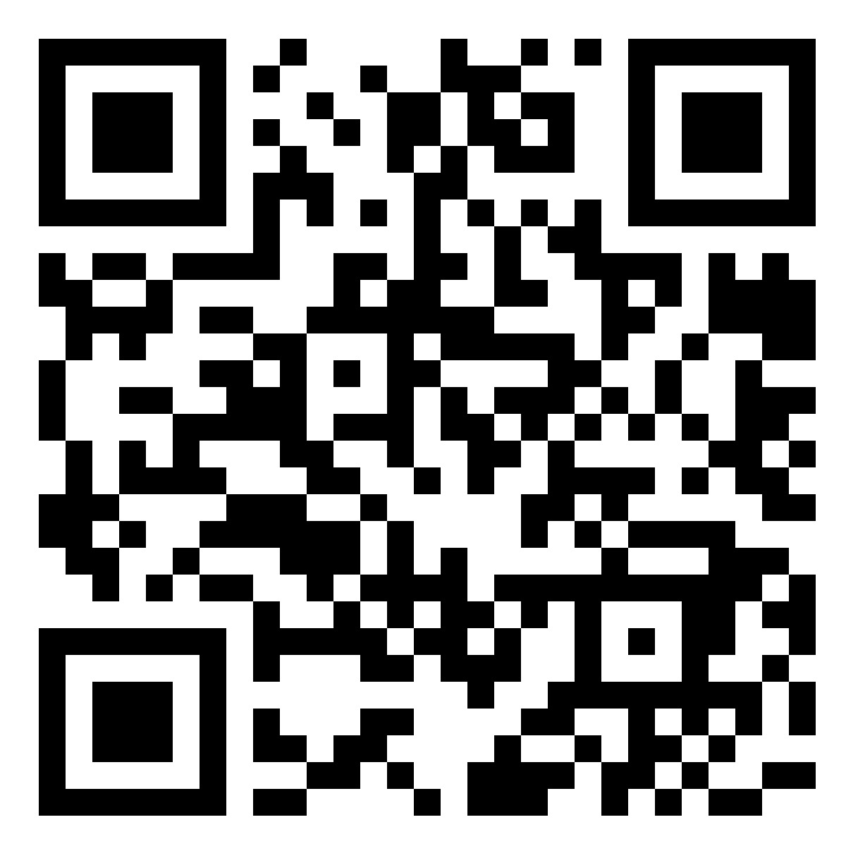
UO Career Center https://career.uoregon.edu/
UO Handshake https://career.uoregon.edu/
The Career Center is here to serve you with job search resources, workshops, and coaching appointments:
Resume Extravaganza drop in
How to interview
How to Write a Cover Letter
Resume & Cover Letters
Search jobs on Handshake
Interviewing Tips & Resources
Practice Interviews
UO Handshake is a powerful tool for your K-12 Education job search in Oregon and beyond.
Handshake is the UO Career Center’s networking site, you can learn more about districts joining the fair and expand your search, filtering for the jobs and locations that interest you.
Bookmark your searches and get job posting notifications sent to your email using the “★ Follow” feature.
https://uoregon.joinhandshake.com

