Slide 1
Faculty Development & Promotions
Christopher Murray
Associate Dean for Faculty Development, COE
6-4-2021

Slide 2
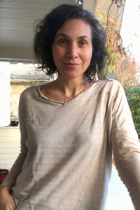
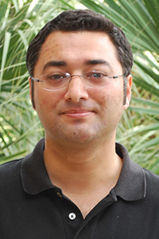
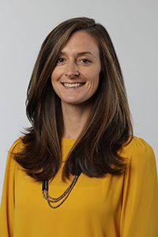
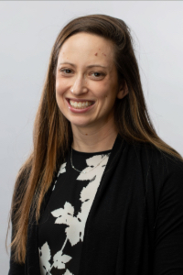
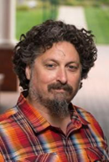
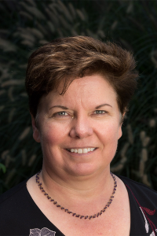
TTF Promotions
EMPL
CPHS
SPECS S
Ilana Umansky, Associate Professor, Indefinite Tenure
Cengiz Zopluoglu, Associate Professor, Awarded Indefinite Tenure
Nichole Kelly, Associate Professor, Indefinite Tenure
Samantha Shune, Associate Professor, Indefinite Tenure
Hank Fien, Full Professor
Beth Harn, Full Professor

Slide 3
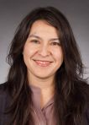
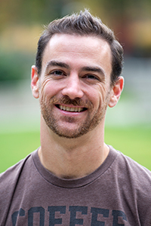
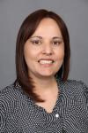
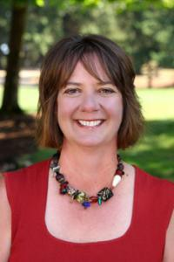
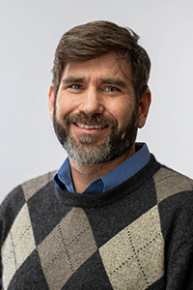
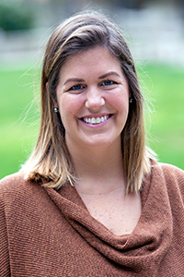
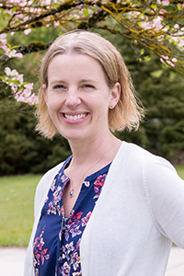
CNTTF Promotions
ECS
BRT
CEQP
SSET
CHD
SPECS s
Erin Chaparro, Research Associate Professor
Daniel Anderson, Research Associate Professor
Fatima Terrazas-Arellanes, Research Associate Professor
Deanne Unruh, Research Professor
John Lind, Senior Research Associate
Jeanine Brush, Clinical Associate Professor
Billie Jo Rodriguez, Senior Lecturer I

Slide 4
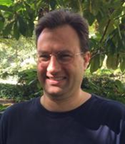
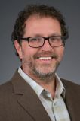
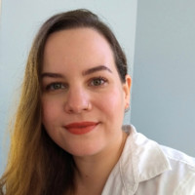
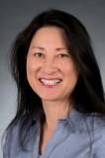
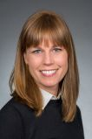
CNTTF Promotions cont..
CTL
Education & Community Supports s
Devin
Sullivan
Patrick Brott, Senior Research Assistant II
Dylan Bragg, Senior Research Assistant I
Rachel Cameron, Senior Research Assistant I
SoLing So, Senior Research Assistant I
Devin Sullivan, Senior Research Assistant I
Danielle Triplett, Senior Research Assistant I

Slide 5
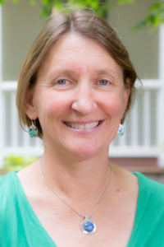
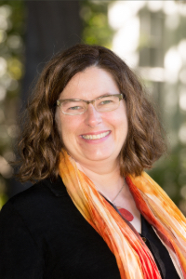
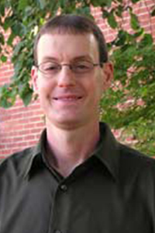
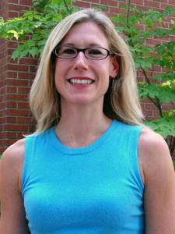
Gratitude & Appreciation
Department Heads
What they do…..
Advising/coaching leading up to process (Annual review, Mid-term review)
Advice/feedback on developing Personal Statement & CV
Identify, select, and recruit external reviewers (rank, AAU, no-conflicts)
Manage external reviews (declinations, identifying replacements, getting CVs from reviewers)
Organize department meetings to discuss cases
Organize and managing votes on cases
Write 2-3 page letter contextualizing your work, external reviews, department discussions, and vote
Last Year Alone
3 TTF cases
2 CNTTF cases
1 Mid-term Review
1 Post-tenure (6-year)

Slide 6
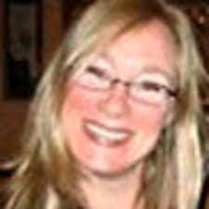
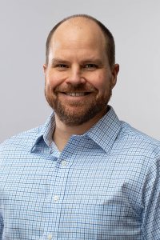
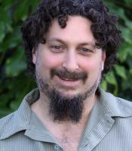
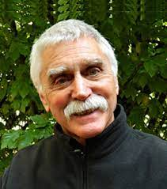
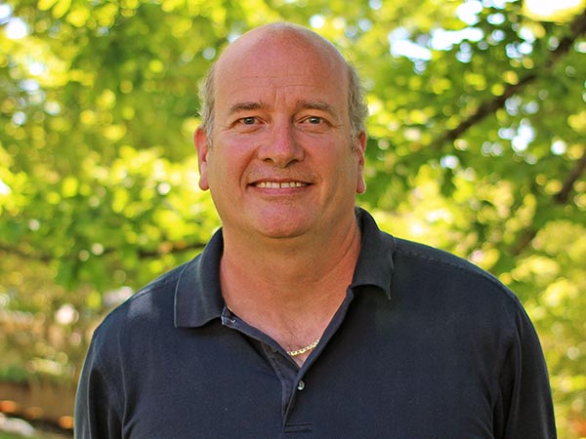
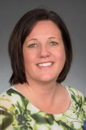
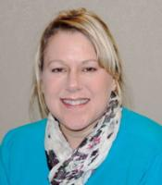
Gratitude & Appreciation
Unit Directors
What they do…..
Coaching on Personal Statement & CV
Identify select, and recruit external reviewers (Research Professor Series)
Manage external reviews (declinations, identifying replacements, getting CVs from reviewers)
Organize unit meetings, discuss cases, organize and manage votes on cases
Write 2-3 page letter contextualizing candidate’s work, external reviews, department discussions, and vote

Slide 7
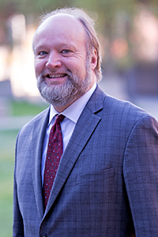
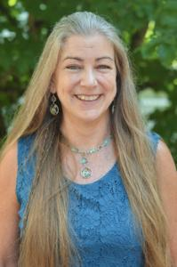
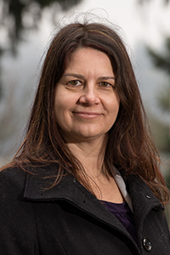
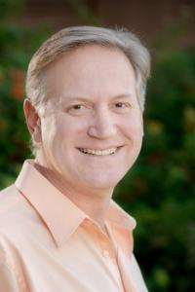
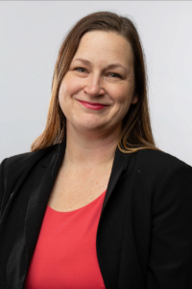
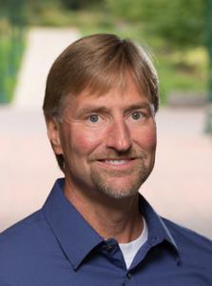
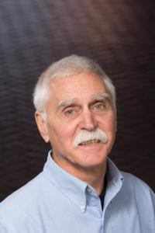
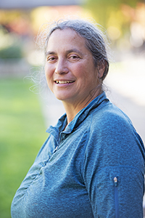
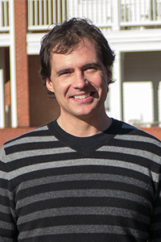
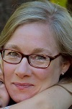
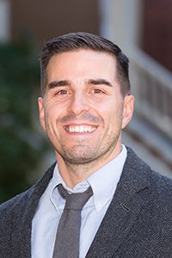
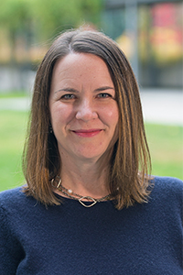
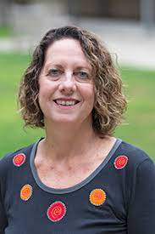
Gratitude & Appreciation
COE TTF Tenure & Promotion Committee (6 cases + *)
COE CNTTF Promotion Committee (13 cases!)
What they do….
Carefully review policies and promotion criteria
Review and discuss each file
Vote on each file
Write a 2-3 page letter describing your case, process, and vote
*COE TTF - Post-tenure reviews & endowed professorship

Slide 8
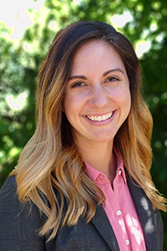
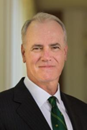
Dean’s Office
Amanda Boehringer Amy Green Dean Kamphaus
2020-21
19 promotion reviews
6 additional major reviews
25 letters + individual meetings!

Slide 9
Please Prepare for YOUR Promotion
As I have tried to convey in this presentation, there are an incredibly large number of people working very hard on making your promotion a success.
Department Heads and Research Unit Directors
Department and research unit faculty
Your colleagues on the COE promotion committees
Numerous people from the dean’s office
We all take this very seriously because we want YOU to be successfully promoted.
Despite this, it is not uncommon for us to hear…why do I have to do that….I don’t have time to do this….I’m just going to do it this way instead…and sometimes flat out “I’m not doing this or that”
This process really depends on you and your commitment to taking the process seriously. The guidance you receive from department heads and us is not an attempt on our part to make you waste your time preparing unnecessary materials….Rather, we actually have an intimate understanding of this entire process and our ONLY goal is to facilitate your successful promotion

Slide 10
Therefore…..
Basic Expectations/Tips
Read your promotion policy: At the end of this meeting, we will be sending out the CNTTF policy, the TTF policy, and the CBA
Keep your CV updated & in the recommended format (it will be included in email)
Save pdfs of all scholarship documents (journal articles, book chapters, reports, etc.)
Save your teaching documents (syllabi, PowerPoints, peer evaluations. NOT ratings, we gather those for you)
Save any available documents pertaining to service contributions (letters from UO committees, community, state, national)
Read & save the equity and inclusion document (it will be included in email)
Save materials from each of your prior reviews (mid-term, major review)
During the year when you are preparing your materials
Ask a colleague who has recently gone through promotion for feedback on your CV or personal statement;
ask your department head or unit director for feedback;
ask me for feedback
During the year when you are preparing for a major review/promotion, assume that you will dedicate between 30-40 hours to gathering materials, formatting your CV, developing your personal statement
Yes, these slides will also be included in the email!

Slide 11
Going Forward
Please also visit Office of the Provost site https://provost.uoregon.edu/academic-personnel to learn about the processes and procedures associated with promotion.
This summer, I will be developing a draft revision of our existing P&T policy (TTF) to better align it with the materials included on the OtP website, particularly with regard to dates.
We will be sending this out to faculty in the Fall for review, recommendations, vote.
Congratulations again to those of you who were promoted, and
Thank you again to everyone who contributed to the successful promotion of 19 of our colleagues.

